Slide 1
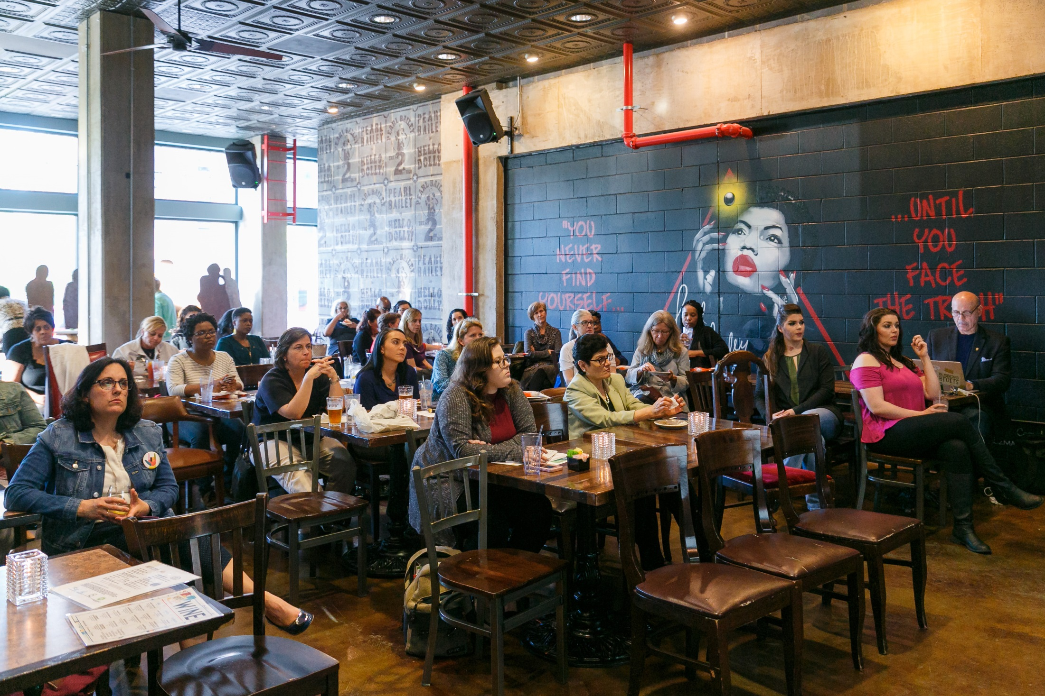

Notes:
[This slide is projected on the screen until we start the program.]

Slide 2





Mental Health
Place Based Care
Care Coordination
Health Literacy
Community Health Needs Assessment: http://assets.thehcn.net/content/sites/washingtondc/2016_DC_CHNA_062416_FINAL.pdf
Notes:
6:15pm – 6:20pm: Emcee welcomes everyone, introduces yourself (be sure to highlight your prior roles in the school system and your current role at CNHS), thanks everyone for coming, etc. Then the emcee provides some context – see below:
The cafes are hosted by CNHS/GW through funding provided by a large NIH grant called the Clinical and Translational Science Awards. The purpose of the grant is to bring research/clinical innovation to the community in an timely and ethical manner. The grant has many core areas, one of them being “Community Engaged Research.”
The Community Engagement Core organizes the Science Cafes. The cafes are intended to create a space where researchers and community groups/reps can co-mingle, share, and build trust.
This current café is the 11th café in the series. We’ve had topics ranging from mental health to asthma to sickle cell disease. We always happy to see familiar and new faces in the audience.
We base the café topics on community-identified needs. These needs were identified in the 2016 DC Community Health Needs Assessment, conducted by several hospitals and community health centers. The needs assessment is available online at the DC Health Matters website.
The four high priority community needs are: mental health, health literacy, care coordination and place-based care.
Please enjoy the refreshments in the back of the room. If you’d like to order additional food, please feel free (at your own cost). [Find a delicate way to say that…]

Slide 3
Tonight’s Panelists
Dr. Olga Acosta Price – Director of the Center for Health and Health Care in Schools, Associate Professor at the Milken Institute School of Public Health at the George Washington University
Dr. Michael Long – Assistant Professor in the Department of Prevention and Community Health in the Milken School of Public Health at the George Washington University and an expert in obesity prevention
Ms. Marisa Parella – School Based Mental Health Program Manager at Mary’s Center
Dr. Chioma Oruh – Member of the Chancellor’s
Parent Cabinet for DC Public Schools and the DCPS
Early Childhood Education Policy Council
Notes:
We have four amazing speakers here today who will talk with us about the value of partnerships between schools and health systems to improve physical and mental health for students and promote academic success and what research tells us about the components of successful partnerships. Each of these individuals has stretched themselves to develop innovative partnerships, programs and policies, grounded in research, that support students. Joining us this evening are:
Dr. Olga Acosta Price – Director of the Center for Health and Health Care in Schools at the GW Milken Institute School of Public Health and a key figure in school mental health in DC. A clinical psychologist by training, Dr. Acosta Price was the founding director of the School Mental Health Program in DC and currently serves as the co-Chair of the DC Task Force on School Mental Health. In addition to her local work, Dr. Acosta Price leads projects across the nation, advising government officials, education systems and health care institutions on school health programs.
Dr. Michael Long – Assistant Professor in the GW Milken Institute School of Public Health. Dr. Long’s research focuses on using existing data sets, and working collaboratively with schools to use this data, is currently working on projects involving telehealth in schools, school mental health, and school meals/physical activity programs.
Ms. Marisa Parella – Licensed Clinical Social Worker who has been involved in children’s mental health for the past 17 years. Ms. Parella is the Manager of the School-Based Mental Health Program at Mary’s Center, which works in 18 schools in DC, and the parent of 3 DCPS students.
Dr. Chioma Oruh – Disabilities rights parent advocate and co-founder of Mothering Hands, a parent-led nonprofit helping families of children with disabilities navigate the systems of care in DC. She is the parent of 2 children who are on the autism spectrum and serves on numerous task forces and advisory groups in DC as a champion for children with disabilities and their families.
Then you can turn the program over to Olga to begin; we usually let each speaker present and then after the last speaker we will flip to the following slide:

Slide 4


BUILDING COMMUNITY AT THE INTERSECTION OF HEALTH AND EDUCATION

Slide 5
About The Center for Health and Health Care in Schools (CHHCS)
National Center that supports child wellness and success in school by promoting collaborative solutions and partnerships in communities that bridge health and education
Only policy, resource, and translational research center housed in a school of public health (Milken Institute School of Public Health at the George Washington University)
Utilize a public health approach to advocate for a coordinated system of supports for children and their families

Slide 6
Promoting Equity by….
Addressing Unique Needs of Communities, esp. Vulnerable Populations
Improving Long-Term Sustainability of Program and Practices
Strengthening School-Community Partnerships

Slide 7
My whole life is stressful. I ran away from home…there was like 13 people in that house…after a while, you know, there’s not enough food and everything for everybody to be there. One winter we had no heat. We had no electricity. We had no water. It was bad.

Slide 8
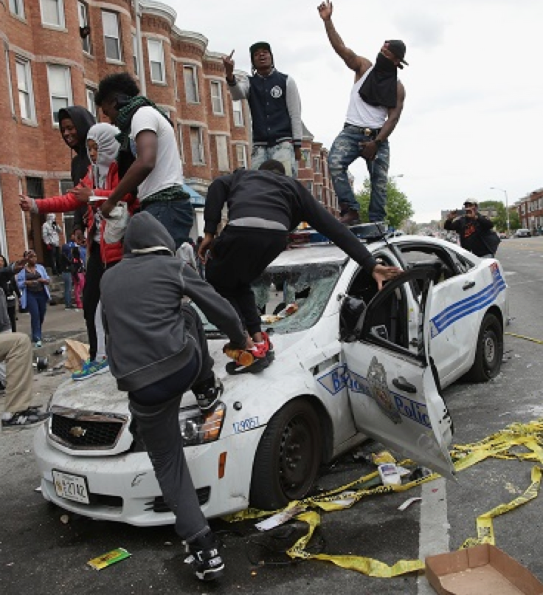
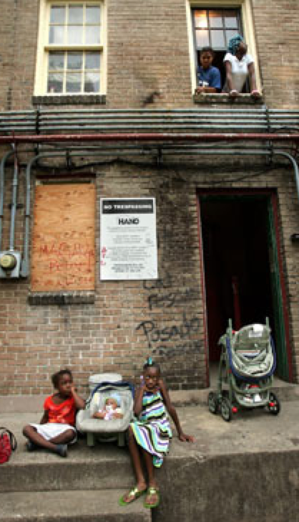

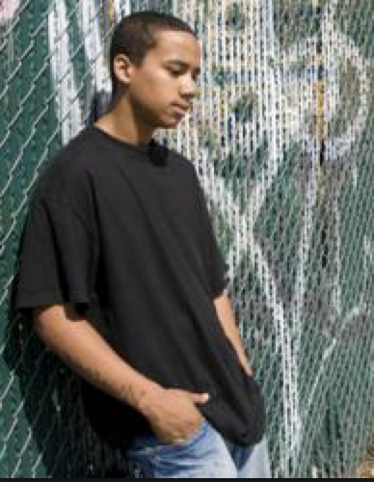
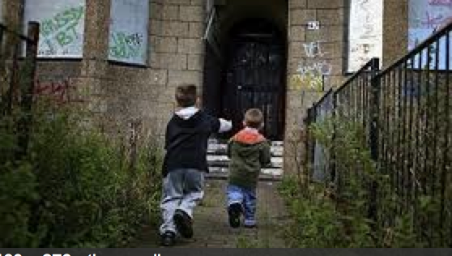
Poverty, Chronic Stress, and Trauma Plague Children and Families
Notes:
More than half of public school students nationwide live in poverty
That is evident in our city as well. About 35% of children reside in Wards 7 and 8;
The percentage of families living below the poverty level in Wards 7 and 8 is about twice the citywide average and about 15 times higher than in Ward 3.
Live in poverty Ward 3: 2%
Live in poverty Ward 7: 25%
Live in poverty Ward 8: 29%
low-income students are at higher risk of health problems that hinder learning, to live in neighborhoods with more violence and fewer resources/infrastructure, and to attend schools with unhealthy environments

Slide 9
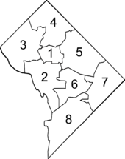
Background on DC
Population in DC under 18 years of age: 111,000
In DC, 47% of youth have experienced a traumatic event, i.e., the death or incarceration of a parent, witnessing or being a victim of violence, or living with someone who has been suicidal or who has a drug or alcohol problem
DC Student Mental Health Status:
  29% HS report they currently use marijuana
  25% HS report feeling sad or hopeless
  13% HS attempted suicide in last year
  25% MS girls seriously considered hurting self
  15% MS girls tried to kill themselves
Washington, DC
Sources: DC Kids Count and 2015 YRBS
Notes:
DC teens experience conflict, assaults, and use some illegal substances at greater rates than the average US high school student. DC youth are also twice as likely to attempt suicide, particularly attempts that require medical attention, than most US students

Slide 10

Mental Health Problems are Prevalent and Begin Early
1 in 5 youth is struggling with some type of mental health problem to an extent that he/she has difficulty functioning
Half of lifetime diagnosable mental illness start by age 14, and about 75% start by age 24
Early onset is associated with greater chronicity and severity
Adverse experiences, traumatic events, and poverty serve as stressful triggers, but these factors can be modified
Notes:
Insell- head of NIMH, MI is the chronic disorder of young people

Slide 11

The Majority of Youth Address Their Health/Mental Health Needs at…..
SCHOOL
Notes:
Of children receiving mental health care, 70-80% receive that care in a school setting
A large percentage of schools provide case management and mental health services, as well as early intervention and prevention programming

Slide 12


Slide 13
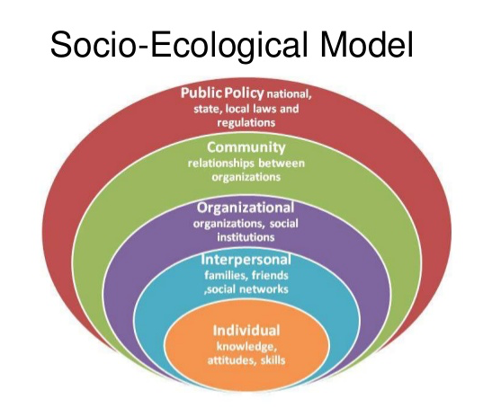
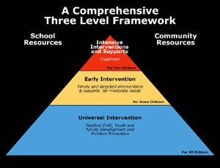
Notes:
Schools have always used a multi-tiered approach familiar and utilized for academic supports, now being applied more to behavioral supports (PBIS)
Intensive/treatments offered for those who have behavioral or emotional difficulties, early intervention to try to identify those with emerging problems before they have a downward spiral, and universal interventions for all kids to help them build competencies and skills, as well as creating positive school climates
But schools are one institution within an entire system with other orgs and resources where we can work to improve availability of support
Well-structured partnerships between schools and communities have been shown to be the most likely solution to building equal opportunities for all
A focus on child development and mental health promotion emphasizes children’s strengths for future success

Slide 14

Rationale
Why a focus on process and not on programs?
Why a focus on environmental conditions and not only on individual change?
Why a focus on school-community partnerships?

Slide 15

SUSTAINABILITY
… the continued use of program components and activities for the continued achievement of desirable program and population outcomes.
Scheirer, M.A., & Dearing, J.W. (2011). An Agenda for Research on the Sustainability of Public Health Programs. American Journal of Public Health, 101 (11).

Slide 16

Systems Change
What factors are associated with broad adoption of social-emotional learning programs and practices?
What conditions are necessary for local cross-sector partners to jointly achieve community-wide impact?
What are the most impactful communication strategies for sharing information with education leaders?
Notes:
Lack of dedicated attention to the systems change necessary to build child development and prevention infrastructure leaves desired and effective programs vulnerable to shifts in program priorities
Public health interventions will only deliver benefits if they are able to focus on just such complex systems change and then to sustain their activities over time.

Slide 17
Qualitative Studies
Synthesis of 44 key informant interviews in 9 states that have had some success in sustaining mental health promotion and prevention programs
Analysis of community conversations with multi-sector coalitions in four communities regarding capacity building for sustaining school-connected mental health initiatives
Focus groups with education leaders about the value of school-community partnerships and the best ways to ignite interest among other education leaders
Notes:
Key informant interviews
Case study methodology
Focus groups

Slide 18
Sustaining Initiatives at State Level
Invest in the cultivation of partnerships and create diverse coalitions.
Establish emotional well-being as an essential component of school success.
Strength-based and inclusive language energizes stakeholders to take action.
Champions with statewide influence help keep a laser focus on the issue.
Assessment is key for sustainability, but consensus on what and how to measure it has not been reached.
Incorporate training into programs for teachers and administrators

Slide 19




SCHOOL-COMMUNITY COALITIONS
IN ACTION
Notes:
Consider mentioning the education advisors that are working with us to build champions within education sector to advance school-community partnerships

Slide 20

Collaboration has been defined as “an unnatural act, performed by non-consenting adults".

Slide 21
Maintaining Strong Cross-Sector Collaboration
Involve partners (including parents) from the beginning of the initiative
Unifying concept is positive/strengths-based and inclusive of diverse views
Focus not on programs but on supporting a process for systemic change- with state leaders facilitating but NOT leading
Need to have patience and be able to tolerate fits and starts along the way
Coalition leadership seen as neutral yet able to provide “backbone”
While funding important, not sufficient ingredient for success
Need access to data and data-sharing agreements

Slide 22


Slide 23
AIMS OF ROUNDTABLE DISCUSSION
Effectively communicate the value of strong school-community partnerships to achieving positive student outcomes
Determine the key strategies and methods for sharing about the benefits of collaborative partnerships to education leaders
Recognize the concepts that facilitate or hinder participation from education stakeholders in broader community initiatives

Slide 24


Framing the Message to
Education Leaders
Start with link between health and learning
  Anecdotal information with authentic voice paired with data
  Elucidate impact of social and environmental conditions
  Explain how health activities will help meet education aims
Address health and risk factors as a community issue, not just a school issue. Schools cannot do it alone
Impart strategies and do not just describe the challenges
  Describe what educators can DO
  Risk factors and learning barriers are not “problems” but circumstances

Slide 25
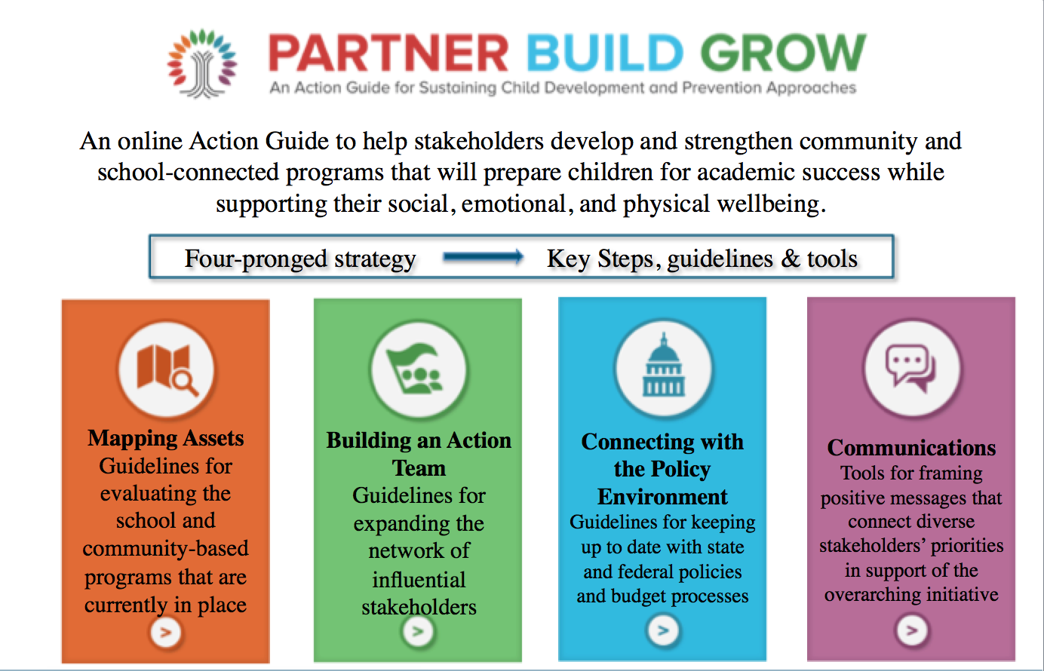

Slide 26



Private-Public-University Partnership
DC SCHOOLS

Slide 27
School Community of Practice (4 schools)
Multi-Tiered System of Support (MTSS)
Focus on Universal Prevention
Data-Based Decision-Making
Collect/use data to conduct quality assessments and ensure fidelity to evidence-based models
Service Coordination With Families, Schools and Community
Improve coordinated systems of care within the school and with community partnerships
Track/assess early identification of at-risk students, identify supports that might benefit them and responsiveness to services, and evaluate student and school outcomes
Engage families, including linking families to resources and supports to reduce stressors
Tailored evidence-based interventions
Validated screening and assessment measures and implementation protocols
Notes:
3 year demonstration project
We will also require all schools to use validated screening and assessment measures and implementation protocols in mental health service delivery. These tools will help to assess what additional areas of needs are for the schools as well as to help us evaluate their progress towards intended outcomes.
To meet the school’s additional needs, they will be given options to incorporate specific tools, best practices or interventions tailored to their schools’ needs, which include social-emotional learning or school climate programs, early interventions like Primary Project, gatekeeper training like Kognito’s At-Risk for Educators, training in trauma and resilience, service navigation tools like Bridge to Success or the Health and Wellness Liaison Program, coordination structures like Care Teams, collaborative approaches like the Collaborative and Proactive Solutions model, and support for staff experiencing secondary trauma. These tools and options will be vetted by our team, and can be included in an implementation plan that will be tailored to each school partner each year.

Slide 28

DC-Wide Stakeholder Learning Community
Researchers
Policy Makers
School Administrator
Practitioners
Convener
Community Members
Community Based Organizations
Build
city-wide capacity, collaborate and leverage resources
Notes:
A bimonthly gathering to:
Inform the design and implementation of strategies to address challenges
Serve as a learning community of school mental health and mental health providers
Build city-wide capacity:
distribute information
share resources (such as training or materials)
build a common set of indictors
link their activities to improve coordination and address gaps in services or capacity

Slide 29

KEY TAKE AWAYS
Need for comprehensive care linking school and community resources
Effectiveness of child health and educational initiatives is dependent on the quality of stakeholder collaboration in AND out of schools
Use data to drive decision-making, to make improvements or expand where things are going well
School staff and parent input important (as critical parts of the community)
Notes:
Don’t forget to focus on tiers 1 and 2 in MTSS

Slide 30

Olga Acosta Price, PhD
Associate Professor, Milken Institute School of Public Health, The George Washington University
Director, The Center for Health and Health Care in Schools
Phone: 202-994-4848
Email: oaprice@gwu.edu
Thank you!

Slide 31
Michael Long, SD, MPH
Assistant Professor
Department of Prevention and Community Health
Milken Institute School of Public Health
The George Washington University

Slide 32
Strategic Science
Identify change agents
Develop strategic questions
Scholarship
Communications
Brownell and Roberto. The Lancet (2015)

Slide 33
Example: Getting Junk Food out of Schools
In 2006, Connecticut's Healthy Food Certification (HFC) offered school districts $0.10 per student per day if they stopped selling junk food on the side of the school meal program
One of the hopes of program was that it would increase school meal participation
Half of the districts joined the program in the first year, which increased to 2/3 by 2009
Long MW et al. American Journal of Public Health (2013)

Slide 34
Getting Junk Food out of Schools
We worked with CT State Department of Education to evaluate whether meal participation went up and revenue effect
Used existing lunch participation data from 904 schools in 154 districts from 2004-2010
Participation increased overall, with a small decline (1.9%) in elementary school free lunch, a 5% increase in middle school paid, and 4-5% increase across all high school meal programs
Estimated $30,000 revenue increase for average district
Long MW et al. American Journal of Public Health (2013)

Slide 35
Getting Junk Food out of Schools
CT SDE program officer was a coauthor on our publication. Findings communicated to state legislators and other stakeholders
For 2017-2018 school year, 90% of eligible districts are implementing the program
Our findings have been integrated into CDC and USDA publications supporting national healthy competitive food standards
Long MW et al. American Journal of Public Health (2013)

Slide 36
Strategic Science
Identify change agents
Develop strategic questions
Scholarship
Communications
Brownell and Roberto. The Lancet (2015)

Slide 37
Mary’s Center
School Based Mental Health Program
(SBMH)
Marisa A. Parrella, LICSW, LCSW-C
Senior Clinical Manager
mparrella@maryscenter.org
202-674-3754
Notes:
A

Slide 38
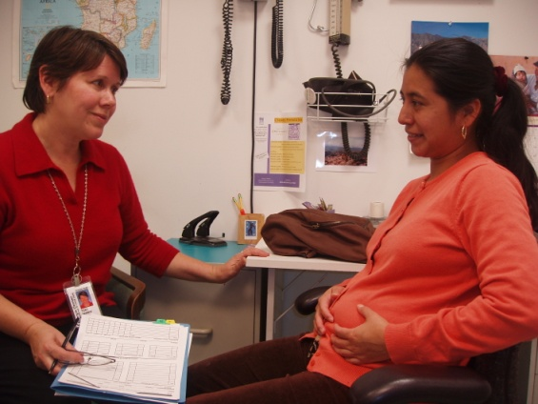

Mary’s
Center
Our Mission:
Building better futures through the delivery of health care, education, and social services by embracing our culturally diverse community and providing the highest quality care, regardless of ability to pay.
Became a Federally Qualified Health Center in 2005
Provide Culturally and Linguistically Appropriate Services
Serve nearly 40,000 socially and medically vulnerable individuals
Historic focus on serving low-income immigrant families
Notes:
A

Slide 39
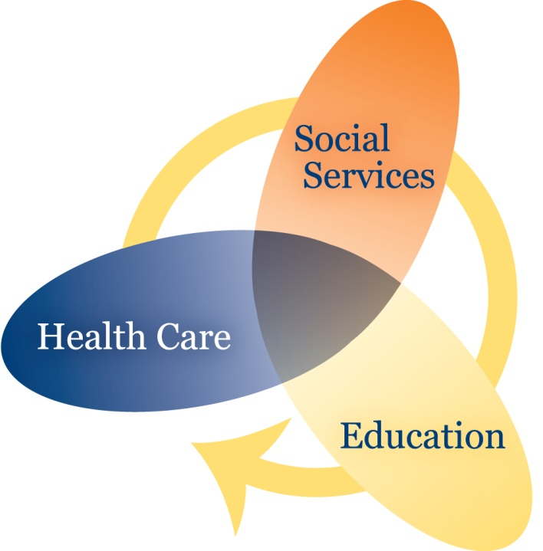
Mary’s Center’s Social Change Model
Saves Lives
Stabilizes Families
Creates Stronger Communities
Notes:
J

Slide 40

Overview of Programs
HEALTH
Prenatal
Pediatrics/Adolescents
Adult Medicine
Psychiatry
Dental
Health Promotion
Chronic diseases
SOCIAL SERVICES
Case Management
Behavioral Health
School Based Mental Health
Senior Health and Wellness
Early Intervention for Children with Special Needs
Home Visiting
Benefits Enrollment Assistance
WIC Program
EDUCATION
Early Childhood Education
English and Computer Classes for Adults
Parenting Classes
High School Diploma
Child Care Credential Training
Medical Assistant Training
Child Care Licensing Technical Assistance
Coaching Hub for Infant and Toddler Child Care Providers
Adolescent Tutoring and College Preparation

Slide 41
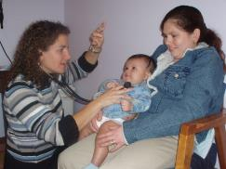


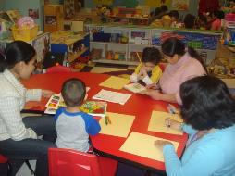
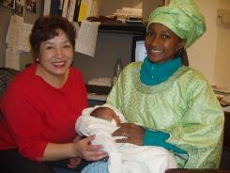
Family Engages Mary’s Center…
Education
Social Services
Health
Notes:
J

Slide 42
SBMH Program Mission
In collaboration with partnering schools in Wards 1, 4, and 5, we strive to increase student, family, and school communities’ attainment of positive mental health and well-being.
Licensed, bilingual, and culturally competent mental health therapists provide on-site diagnostic, therapeutic, and community referral services.
Therapists offer on site mental heath consultation for teachers and staff, individual, family, and group therapy, parent coaching, and linkages to Primary Health and other Community Services.
Notes:
A

Slide 43
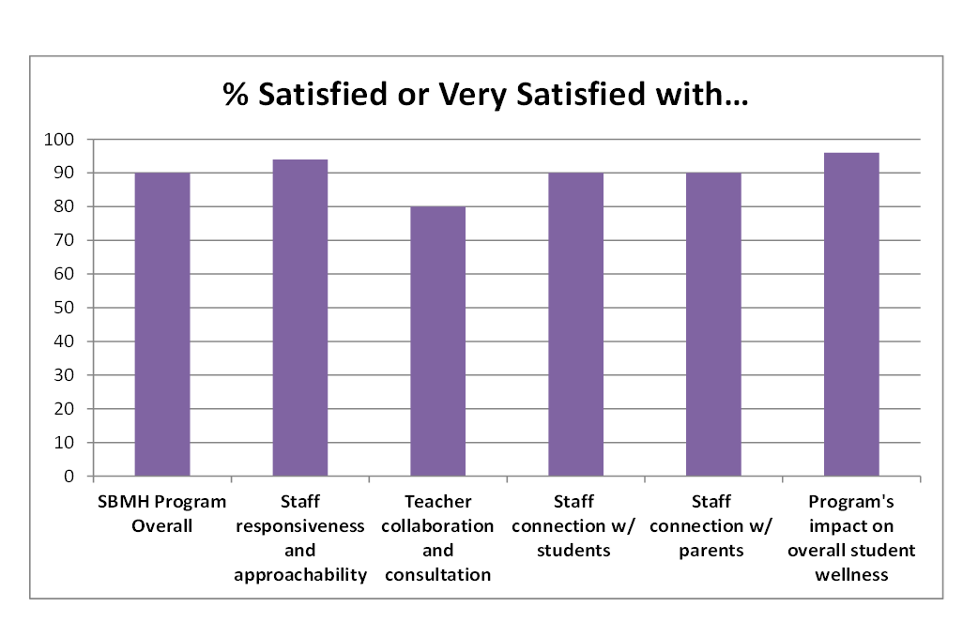
Qualitative Data:
School Partner Satisfaction Survey (n=48)
2015-2016 School Year

Slide 44

Qualitative Data:
Participant Satisfaction Survey (n=98)
2015-2016 School Year

Slide 45
SBMH Five Year Goals
Expand into additional schools to meet high demand for our services.
Increase evidence based consultation and training model to expand Tier 2 Services.
Enhance outcome and evaluation to measure impact on school culture.
Establish a sustainable model for community support services through grants, government contracts, and fee for service.
Integrate more evidence based practices and training for clinicians.

Slide 46
Democracy in Education:
The Importance of Parental Involvement
By
Chioma Mary Oruh, Ph.D.
Parent Advocate and Education Consultant

Slide 47
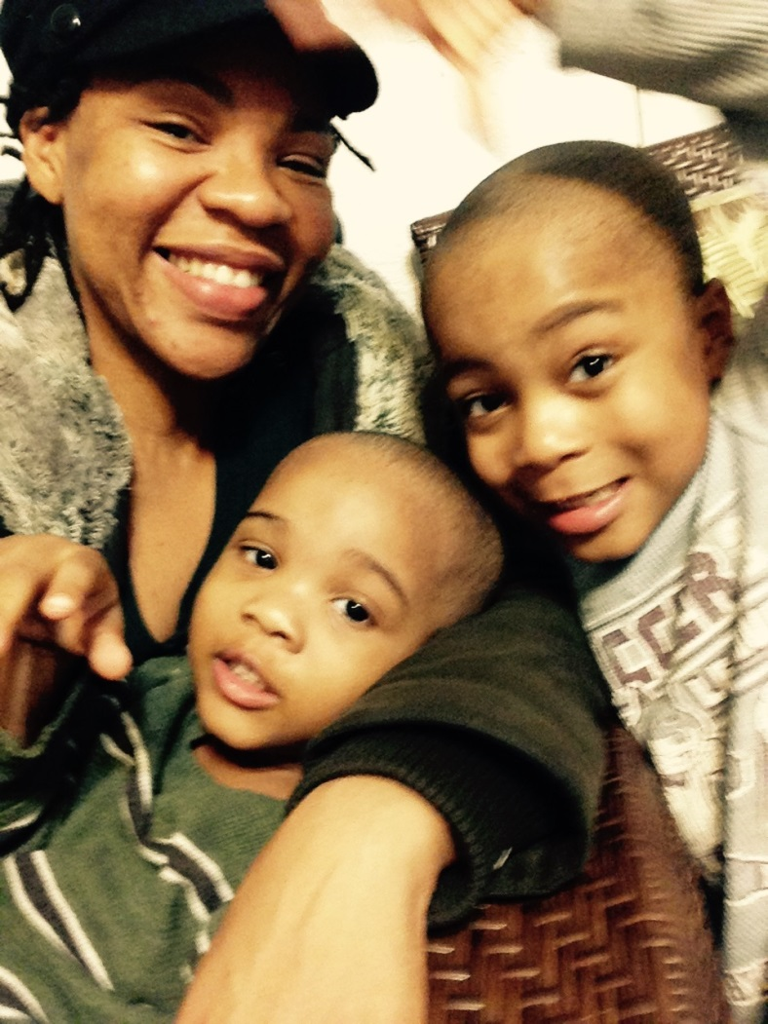
Azubike: My Family, My Motivation

Slide 48
Lieux de Memoire: History as the Center Piece of Democracy
“People who remember court madness through pain, the pain of the perpetually reoccuring death of their innocence; people who forget court another kind of madness, the madness of the denial of pain and the hatred of innocence; and the world is mostly divided between madmen who remember and madmen who forget.” – James Baldwin, Giovanni’s Room (1956)

Slide 49
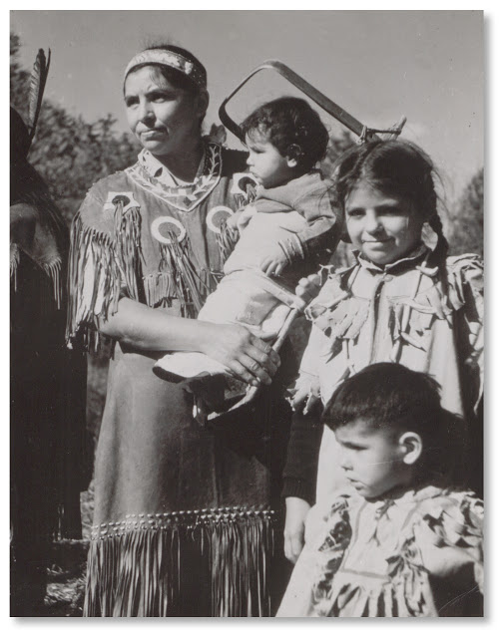
The Evolution of the Family
Anthropologist Lewis Henry Morgan and other 19th century scholars observed indigenous family systems in the Americas such as the Iroquois, which heavily influenced modern American democracy
A “kinship state”, the Iroquois Confederation motivated and inspired by the sacred mother and her children. A matrilineal system that dictated the succession of power between the democratic councils formed between nations in the Confederation.

Slide 50

Family as the backbone of American Democracy
“Perhaps the greatest social service that can be rendered by anybody to the country and to mankind is to bring up a family.” – George Bernard Shaw
The Founding Fathers saw the family as key institution for the education of children, which includes morality and citizenship.
After the American Revolution, Thomas Jefferson called for the creation of a public school system funded by tax dollars but it wasn’t until the 1840s, led by Horace Mann of Massachusettes, that public schools would be formed on a campaign to share core values.

Slide 51
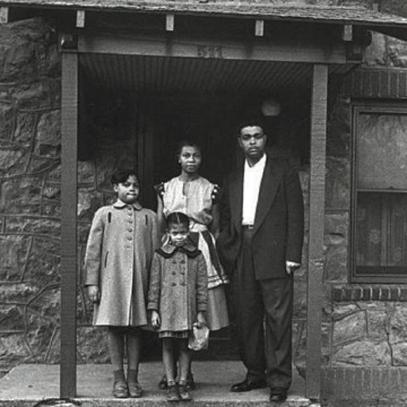
20th Century and Social Justice in Education
In 1951, the NAACP began recruiting families from Topeka, Kansas to take part in the constitutionality of school segregation.
Brown v. Board of Education - Plaintiff, Oliver Brown, had a daughter who was fored to take a bsu to an all-black school rather than attend the all white school a bolc from her house

Slide 52
Shaming and Blaming of Families
“…much of the twentieth century professions of psychology and psyciatry directly blamed family members, especially parents, for causing mental illness in their offspring. Autism was linked to ‘refrigerator’ parents who provided no emotional bonding; schizophrenia resulted from ‘schizophrenegnic mothers,’ whose hostile and dependency-promotng styles drove their children to madness. Spouces, siblings and offspring were part of the ongoing curse. Any consideration of biological vulnerability – including the clear findings that genetic risk is formidable for conditions like schizophrenia, bipolar illness, attention deficit hyperactivity disaorder (ADHD and autism – was discounted.” – Stephen P. Hinshaw, Another Kind of Madness: A Journey Through the Stigma and Hope of Mental Illness (2017)

Slide 53

Disability Rights as Civil Rights
White families of children with dsabilities saw the civil rights movement as a nopporunity to join forces alto demand equal treatment, equal access and equal opportunity for people with disabilities
Parent advocates were at te forefornt, demanding their children be deinstintionaized and be placed into the public school system
By 1973, the Rehabilitation Act was passed, becoming a landmare legislation to as the rights of people with disabilities progected by law S
Section 504 of the Rehabilitation Act provided equal opportunity ofr employment wi, prohbilityng discimnation on the basis of either physical or mental disability
1975 the Education for All Handicapped Children Act was passed to guaranteed equal access to public education for children with disabilities. I t was renaed in the 1990s the Inditvidals with Disabilities Ecuation Act.
Ater decades of campaigning, the Americans with Disabilitis Act passed in 1990, wit much more activism needed to unpack explict and inmplict

Slide 54
Crisis in Parenting = Crisis for Children
16% of low-income families (families earning less than 200% of poverty) have a child with a disability; 9% have a child with a severe disability. This is nearly 50% higher than the rate among higher-income families. The percentage is particularly high among welfare families -20% of these families have a child with a disability, including 13% where a child has a severe disability.
According to the 2000 US Census, among families with one or more members with a disability, the poverty rate was 12.8% - higher than the 9.2% for all families and 7.7% for families without members with a disability.
The same 2000 US Census noted that families with a female household (totaling 12.5 million families) with no husband present were more likely than other types of families to report having members with a disability. 34.8% of these families reported one or more member with a disability, compared with 27.3% among the 55.5 million married-couple families and 31.6% among the 4.3 million families with a male household with no wife present. Divorce following the birth of a child with a severe disability has been cited as the primary factor leading to a single-mother headed household for families with children with disabilities.

Slide 55
Crisis in Parenting = Crisis for Children
Nearly 24% of families with children who have special needs cut back or stop working in order to care for their child or children with disabilities.
“Children with Disabilities and Other Special Needs: Opportunities to Participate in Quality Programs Must Be Expanded,” Children’s Defense Fund (2003), http://www.childrensdefense.org/library/data/children-disabilities-special-needs-opportunities-participate-quality-programs-expanded.pdf, accessed July 19, 2017.
“Disability and American Families: 2000,”US Census Special Reports (July 2005), https://www.census.gov/people/disability/files/censr-23.pdf, accessed July 20, 2017. “Disability and American Families: 2000”

Slide 56

Inclusive Education = Democracy at Work
Inclusion of Parents
Inclusion of Community at Large
Supported Decision Making
Person-Centered Education

Slide 57
Where Do We Go From Here
Chioma Mary Oruh, Ph.D.
chioma.oruh@gmail.com
202-697-3529
Inclusive Prosperity Coalition
www.ipc-dc.org
Mothering Hands, Inc
www.motheringhands.org

Slide 58

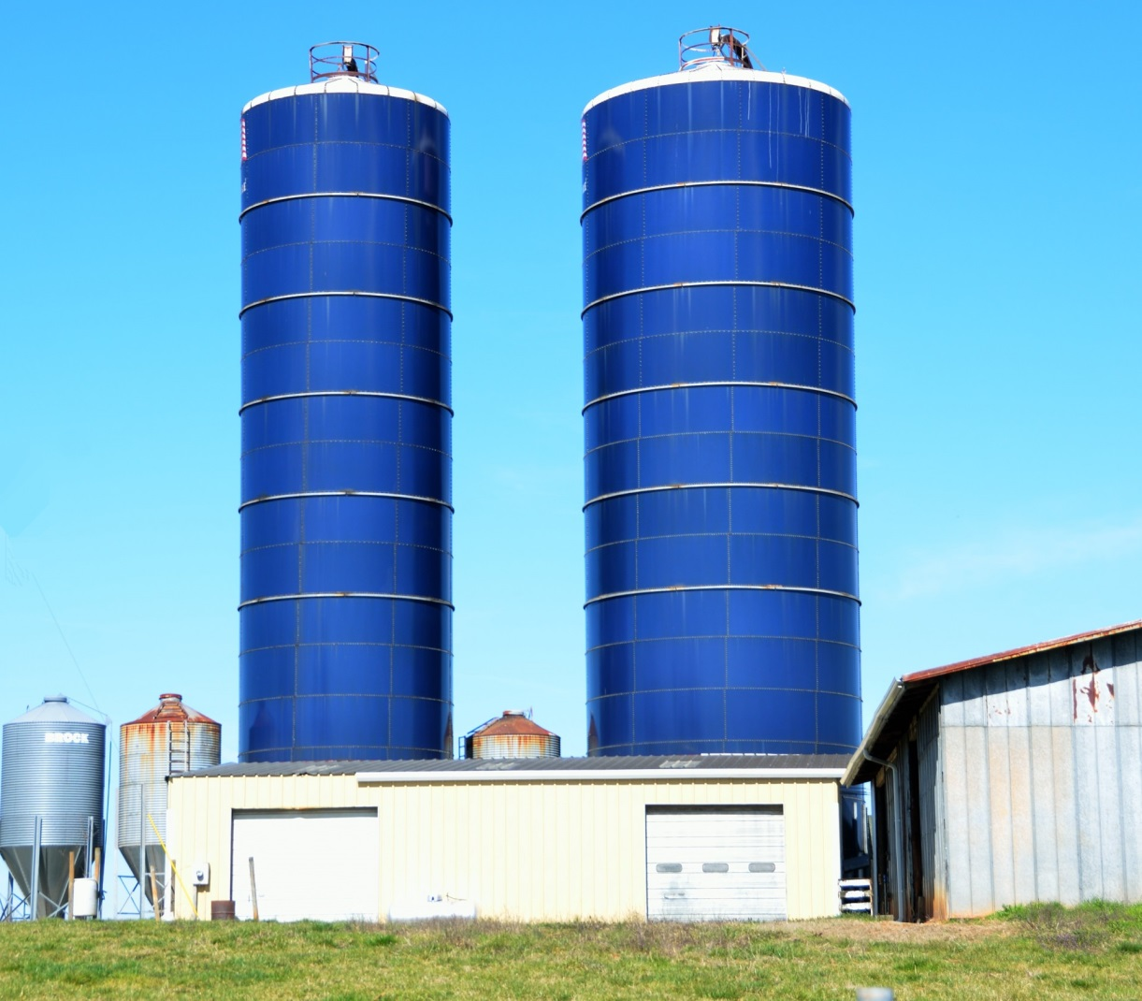
Bridging the Silos
Health
Education
Notes:
Thank you to our speakers for an excellent presentation tonight. We hope you take away from this the efforts to build bridges between the health and education sectors, and using research to do it and develop strong partnerships. Now we would like to open it up to questions from the audience. Our speakers will also be available after the program. Please wait for a microphone to ask your question. (Danielle and Chaya will take the microphone around to audience members).

Slide 59
Children’s National
Internal School Health Collaborative
Children’s National is a school-friendly health care system designed to help all children reach optimal health and achieve their fullest academic potential.
For Children’s National Employees Only
Next Meeting: January 23, 2018 from 9-11am
Join us! Email Cynthia Adams at cnadams@childrensnational.org
Notes:
After the questions wrap up, please do these closing slides-
For all of the CNHS employees in the audience, please consider joining our School Health Collaborative – our next meeting is January 23 and you can email Cynthia Adams to join the mailing list.

Slide 60
Community Stakeholder Meetings:
Improving Care Coordination Between the
Education and Health Sectors
Help identify ways to improve care coordination between the two sectors and make health systems more school-friendly
Meetings will be held in Winter/Spring 2018
Email Danielle Dooley if interested: dgdooley@childrensnational.org
Notes:
For all of our community members who attended tonight, CNHS will be conducting community stakeholder meetings in February and March 2018 and we invite you to participate. Please email or speak to Danielle Dooley, who is here tonight, if you are interested in participating.

Slide 61
Winter and Spring 2018 Science Cafes
Dates to be Announced Soon
Notes:
Thank you again for attending the Science Café. We look forward to seeing you in 2018.

