Slide 1
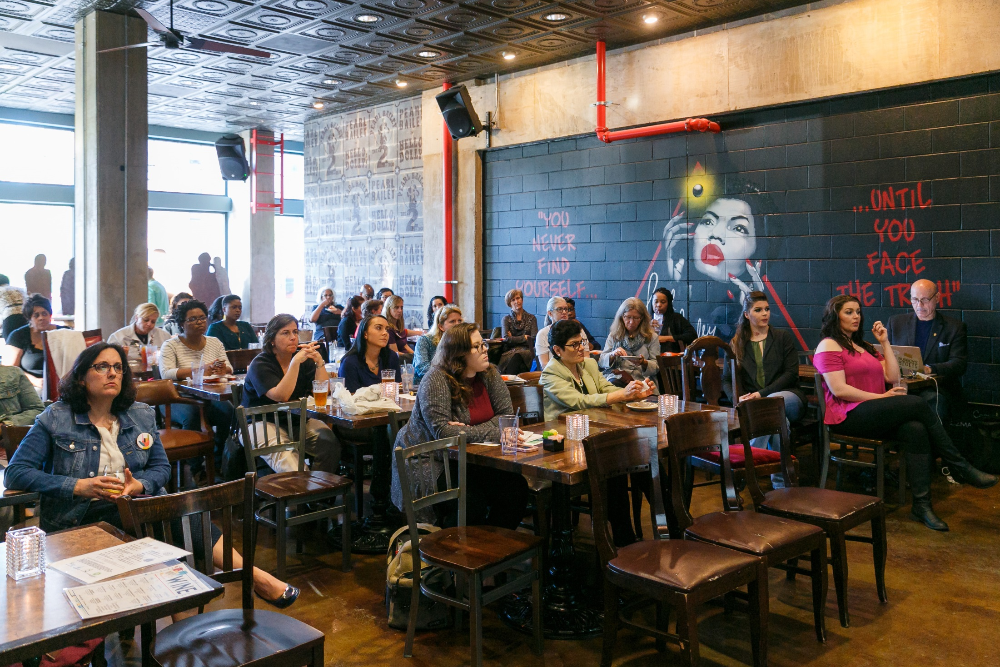


Slide 2





Mental Health
Place Based Care
Care Coordination
Health Literacy

Slide 3
Tonight’s Panelists
Dr. Anna Penn – Neonatologist and developmental neuroscientist at Children’s National Health System
Dr. Lee Beers – Pediatrician and Director of the DC Mental Health Access in Pediatrics (DC MAP) program and Early Childhood Innovation Network (ECIN) at Children’s National Health System
Gail Avent – Executive Director and founder of Total Family Care Coalition (TFCC), a family-run not-for-profit organization that helps families that have emotional, behavioral, and mental health difficulties

Slide 4
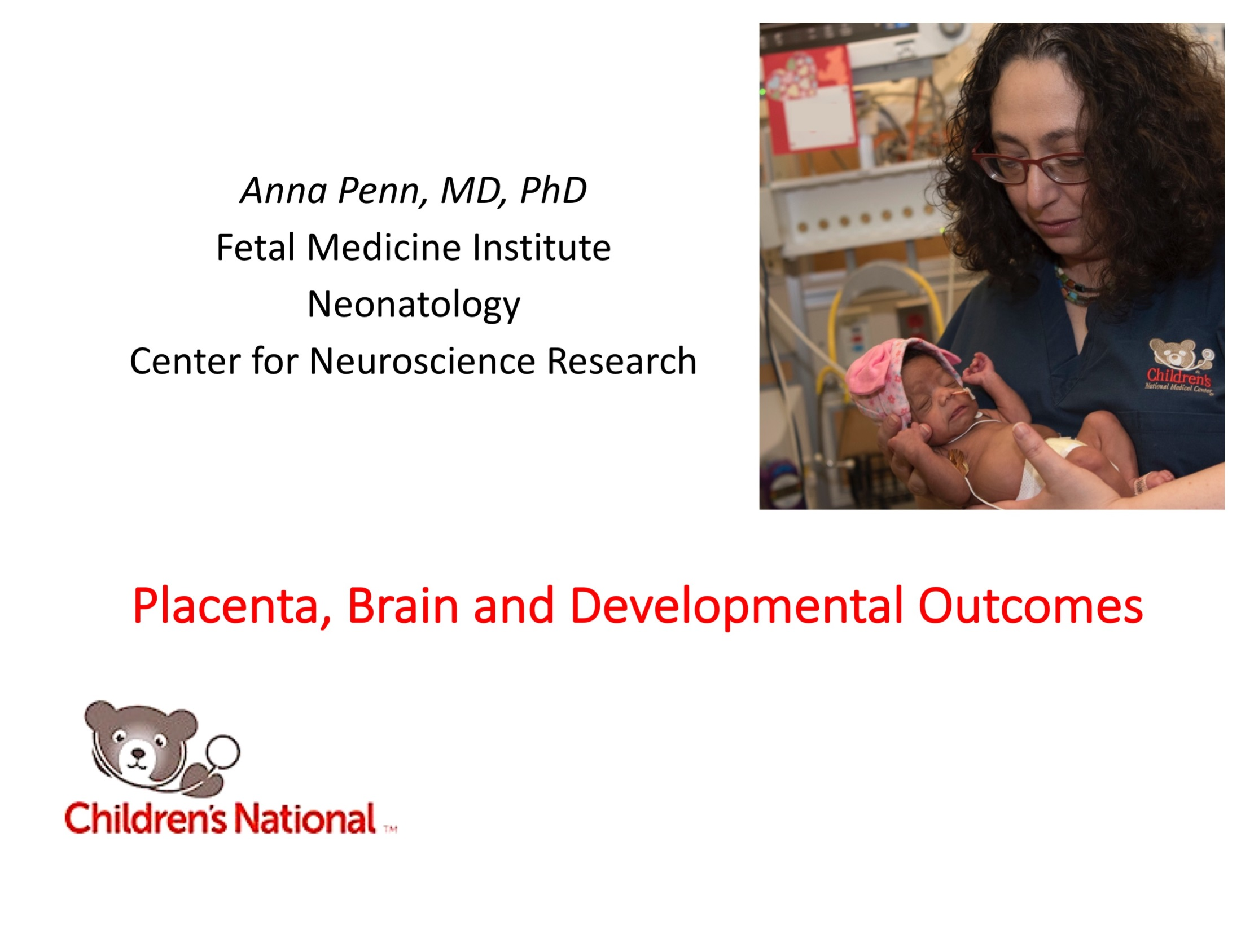

Slide 5
Preterm birth and/or compromise in the womb is linked to a 3- to 4-fold increased risk of psychiatric problems in childhood
Preterm behavioral phenotype:
Poor attention span (ADHD)
Social Difficulties (Autism Spectrum)
Anxiety
Learning difficulties & physical disabilities
  (poor vision, cerebral palsy)
-Johnson & Marlow, 2011

Slide 6
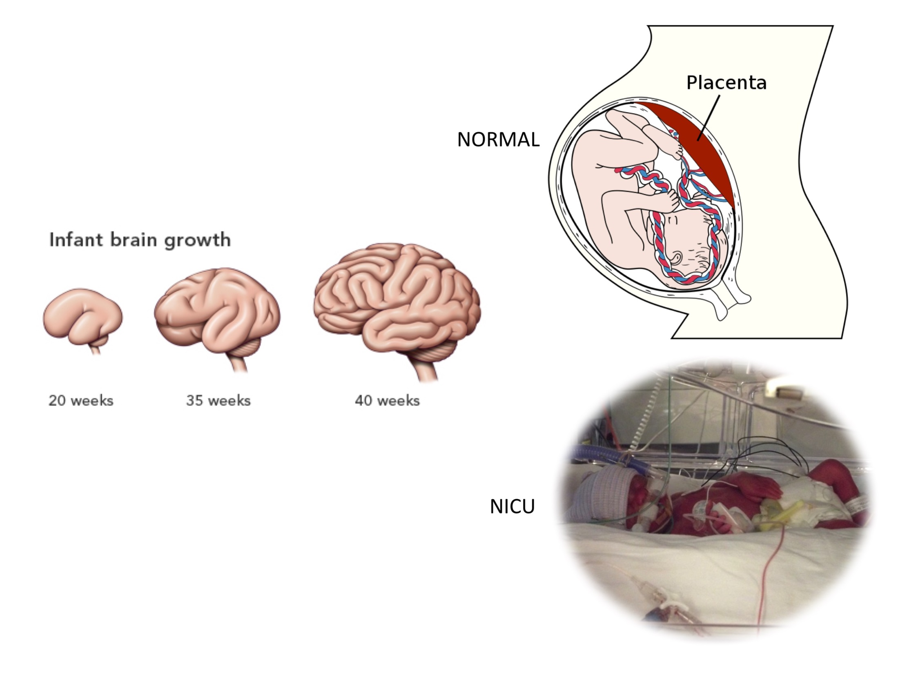

Slide 7
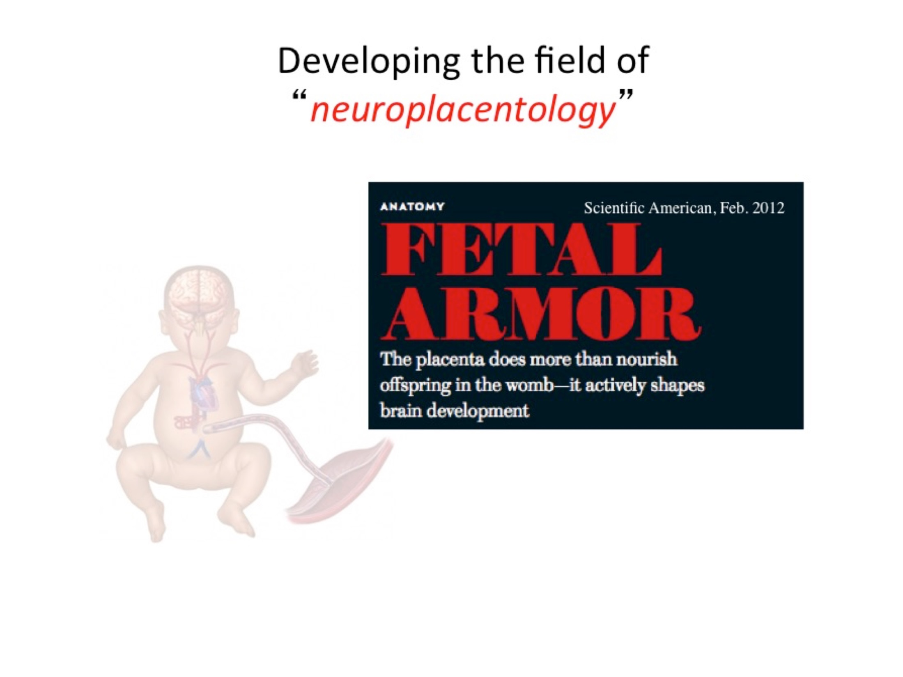

Slide 8
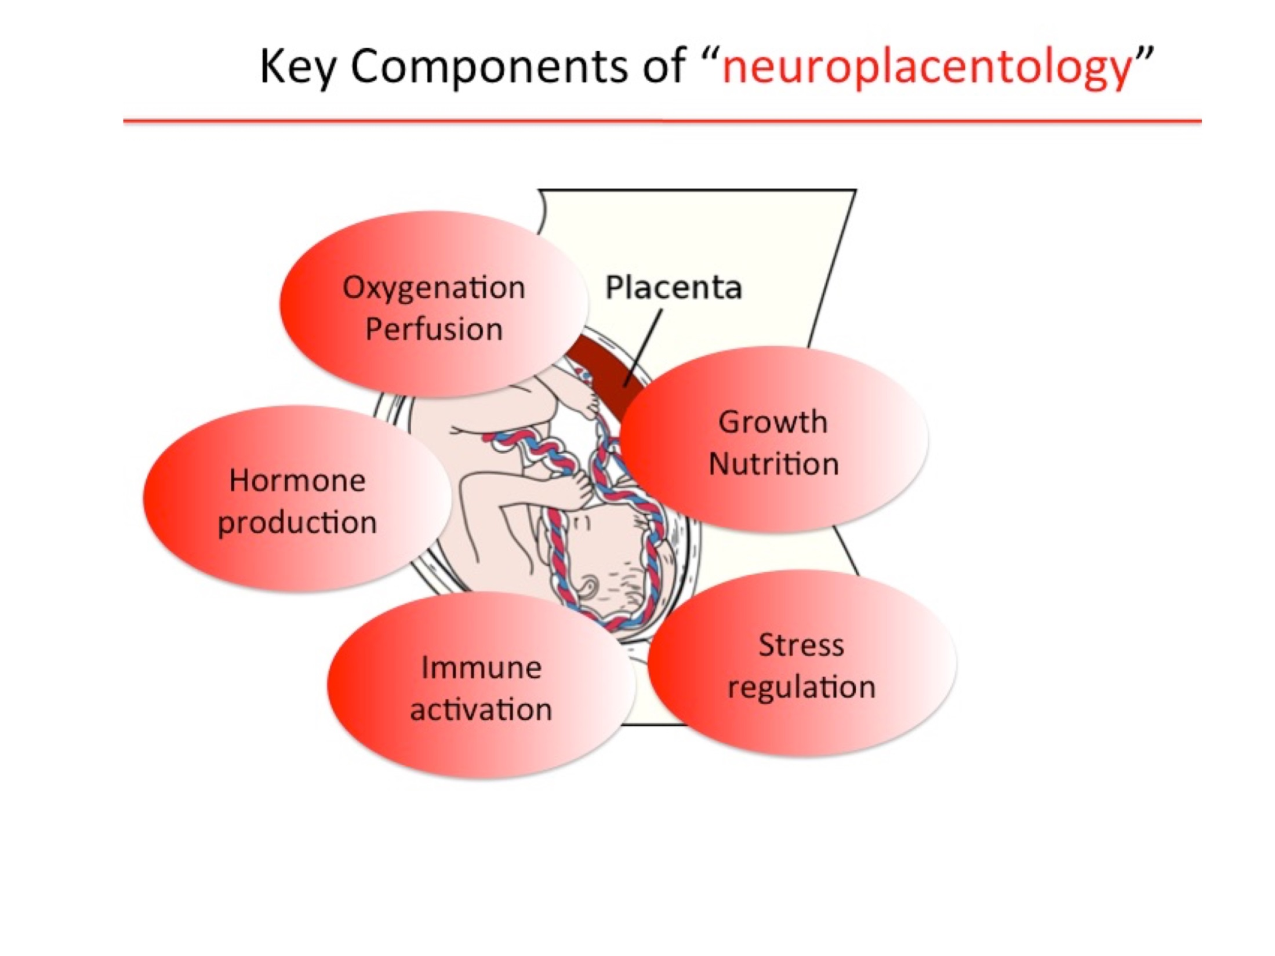

Slide 9
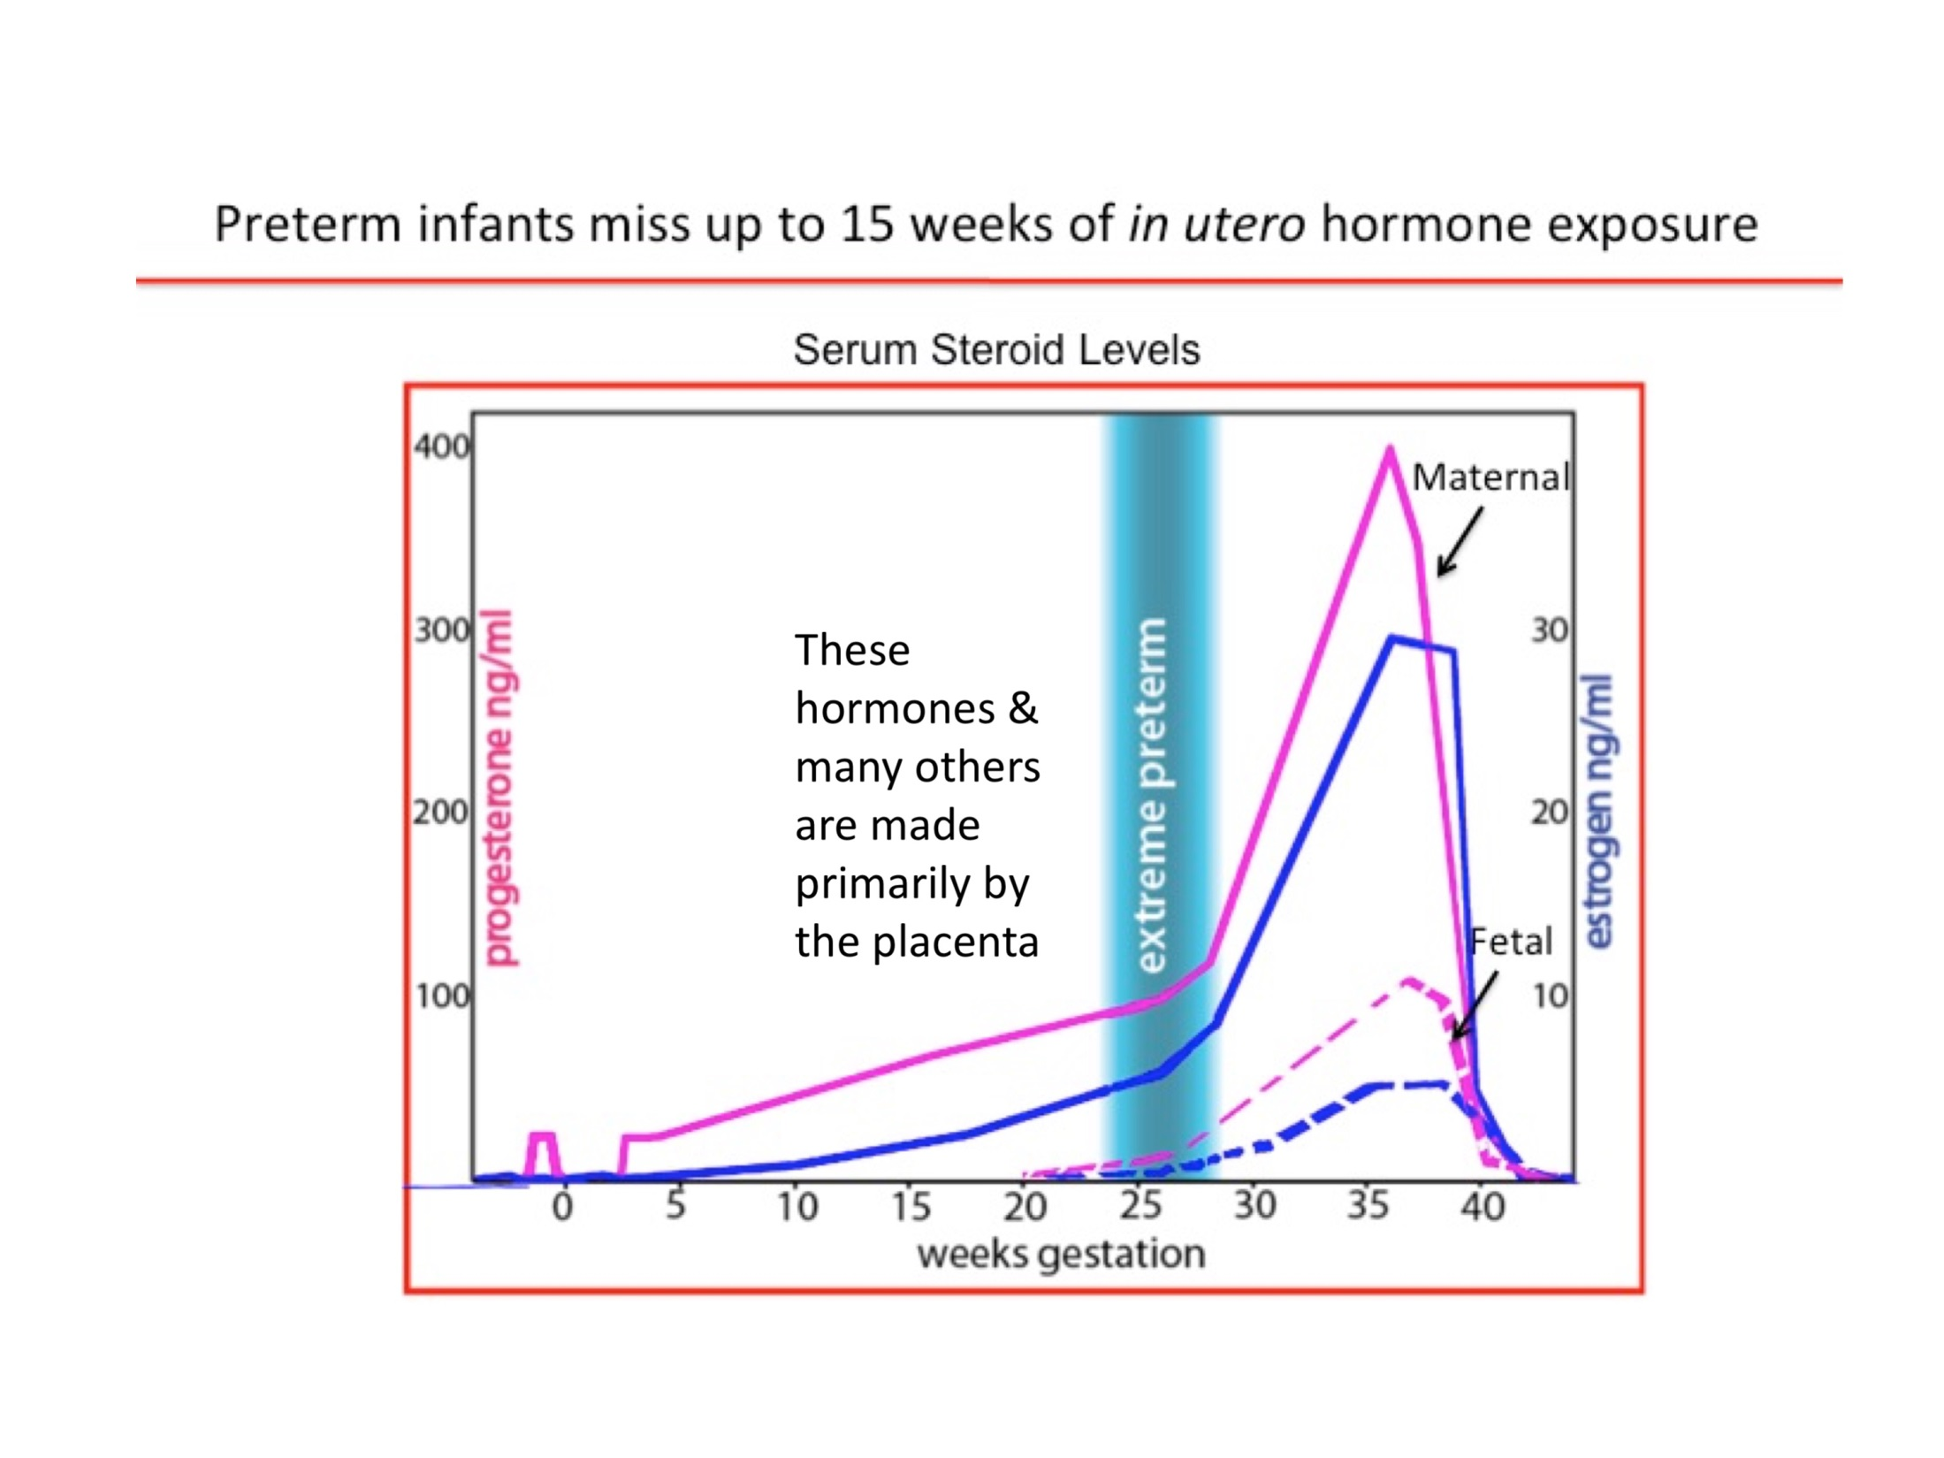

Slide 10
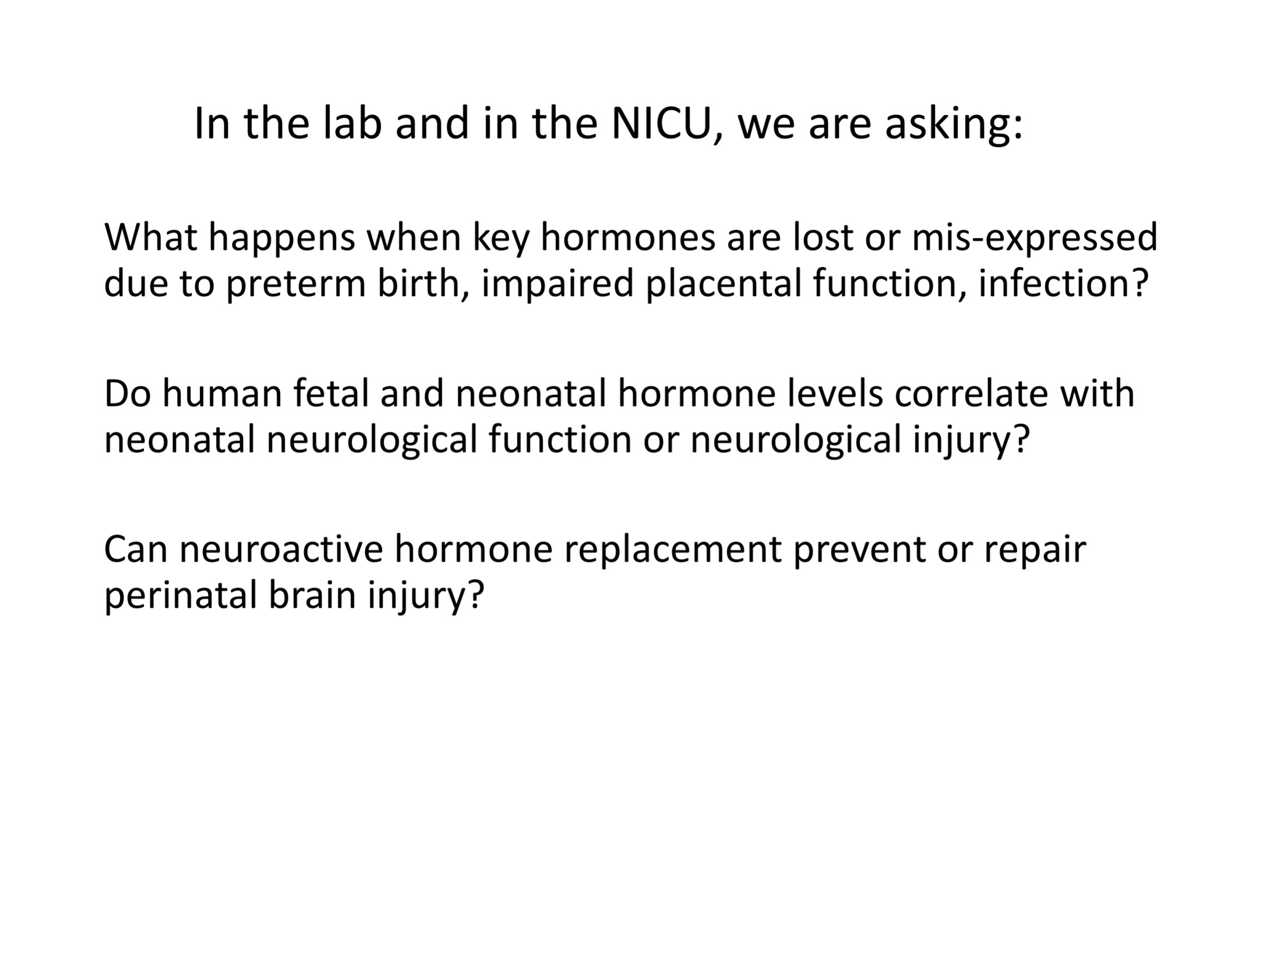

Slide 11
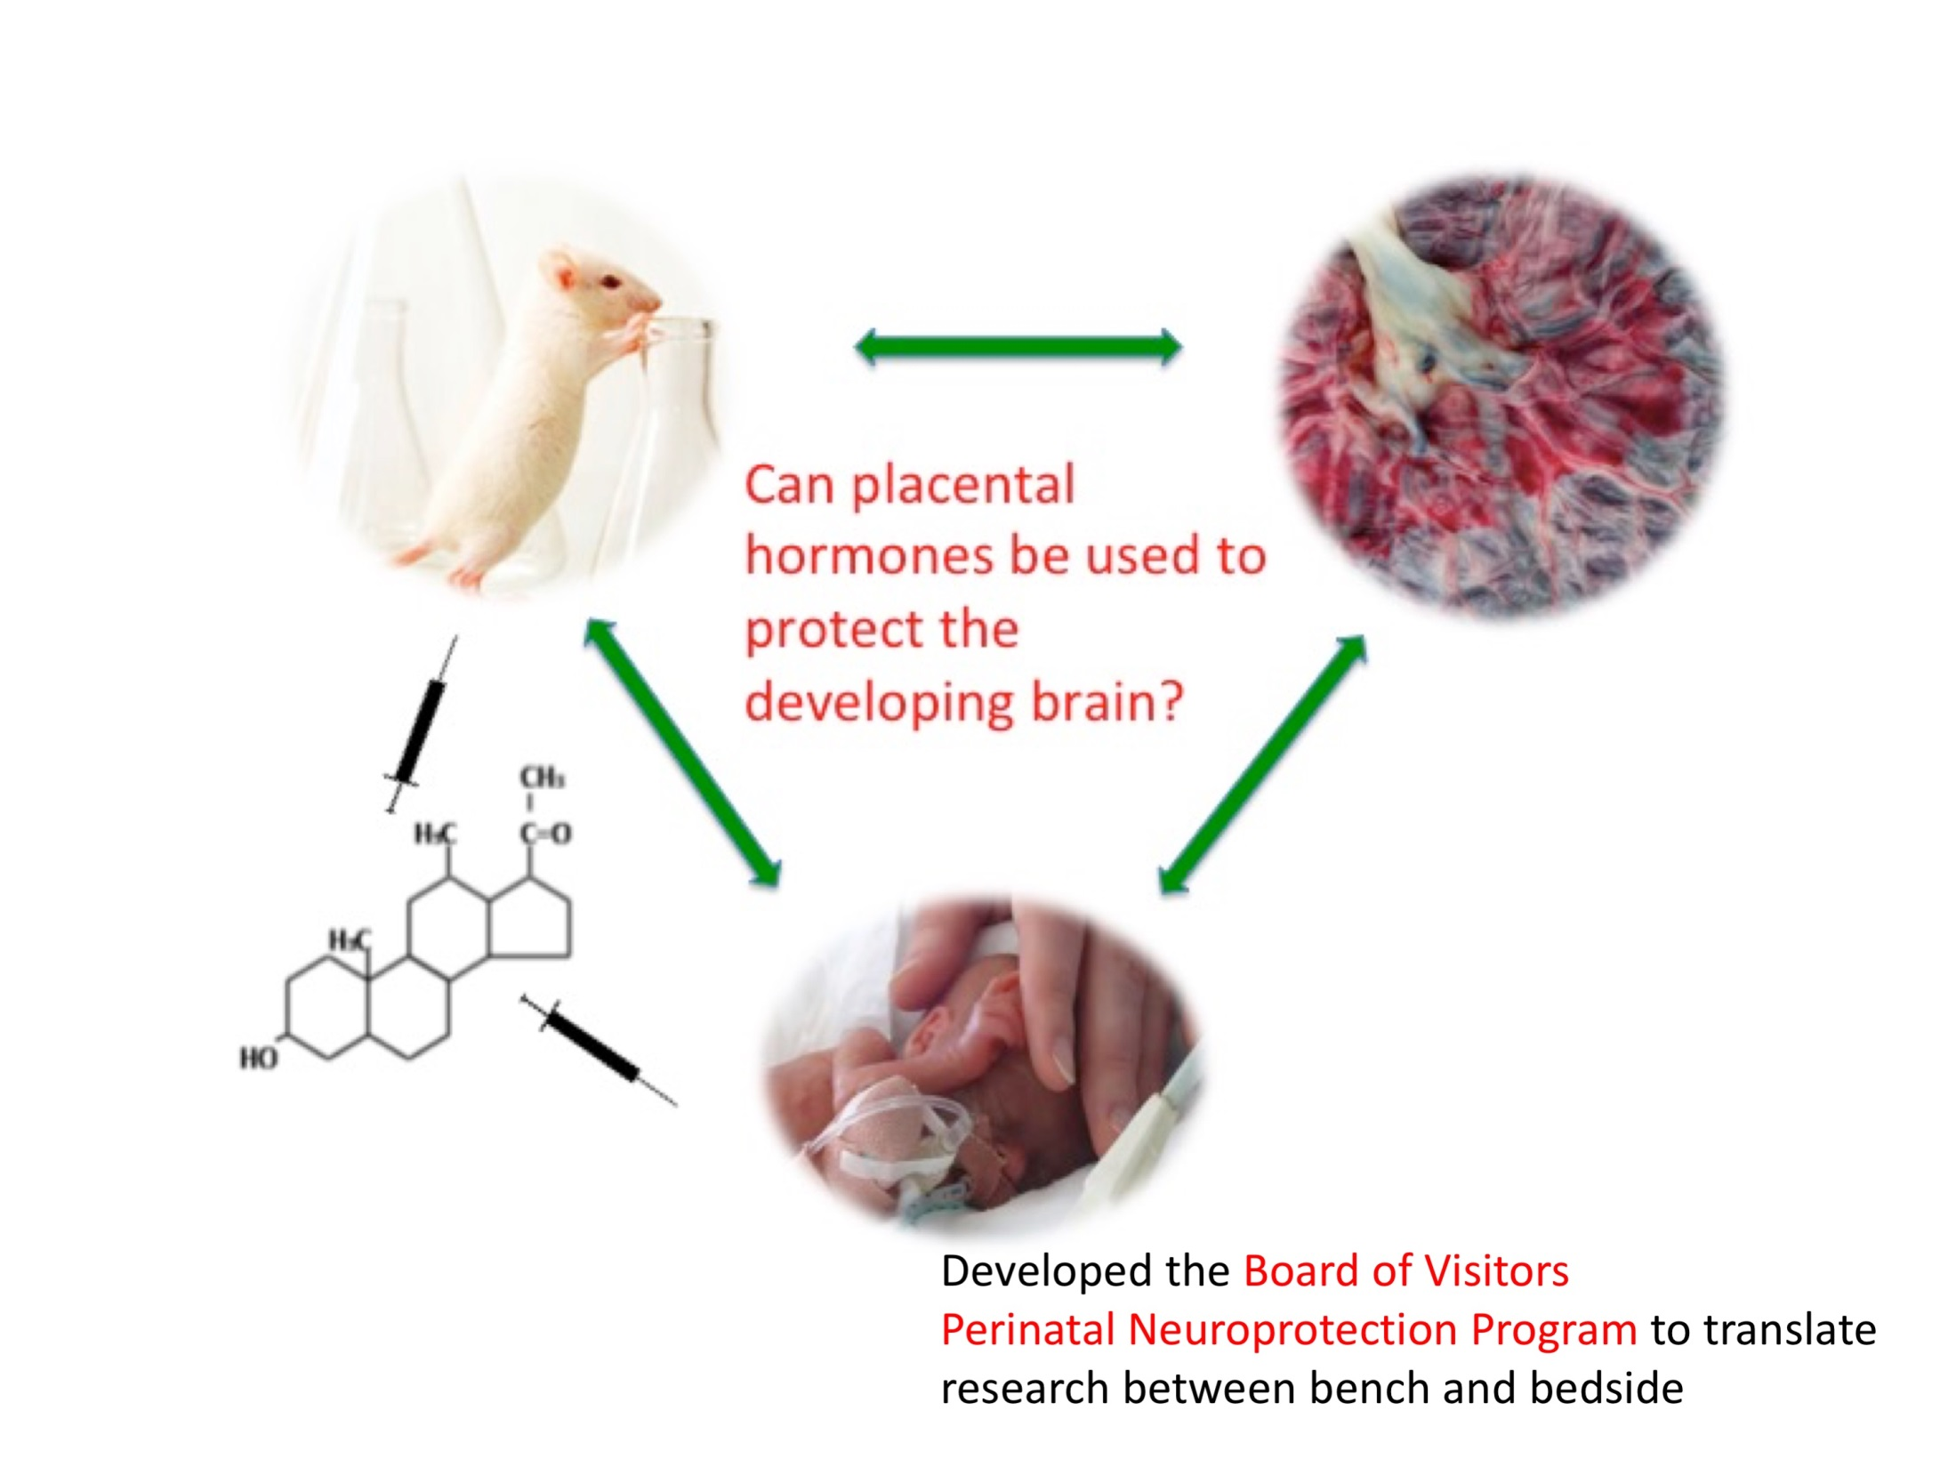

Slide 12
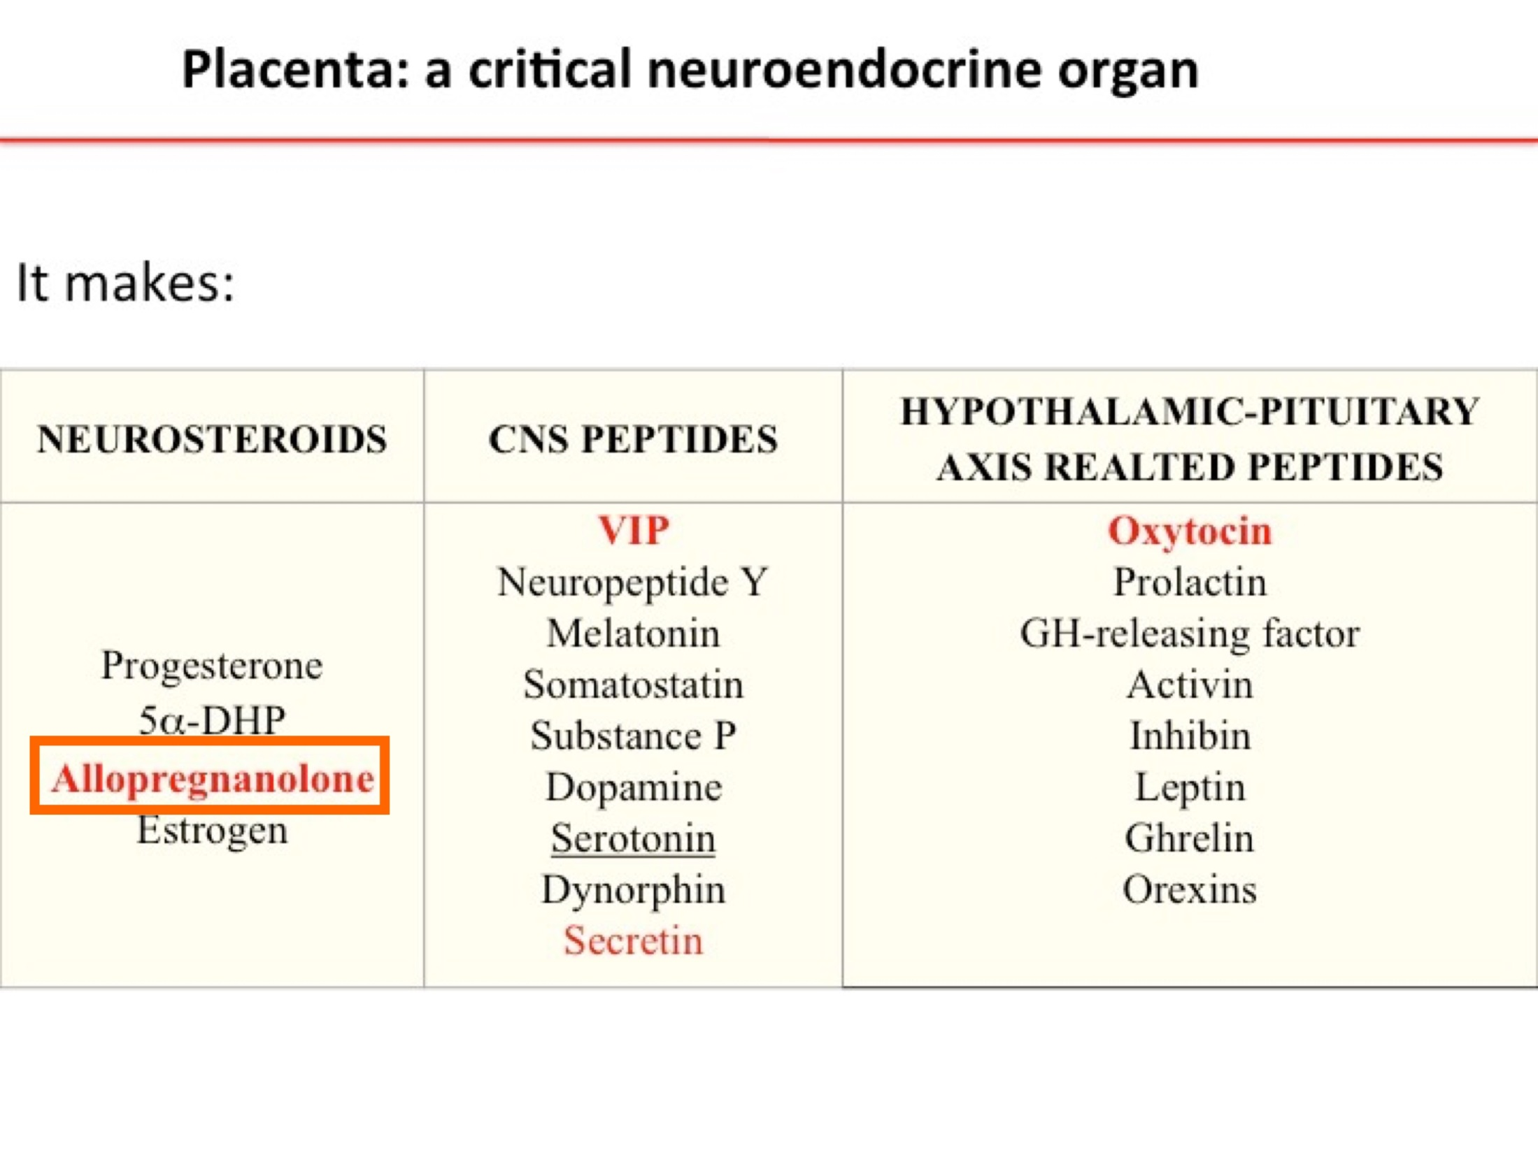

Slide 13
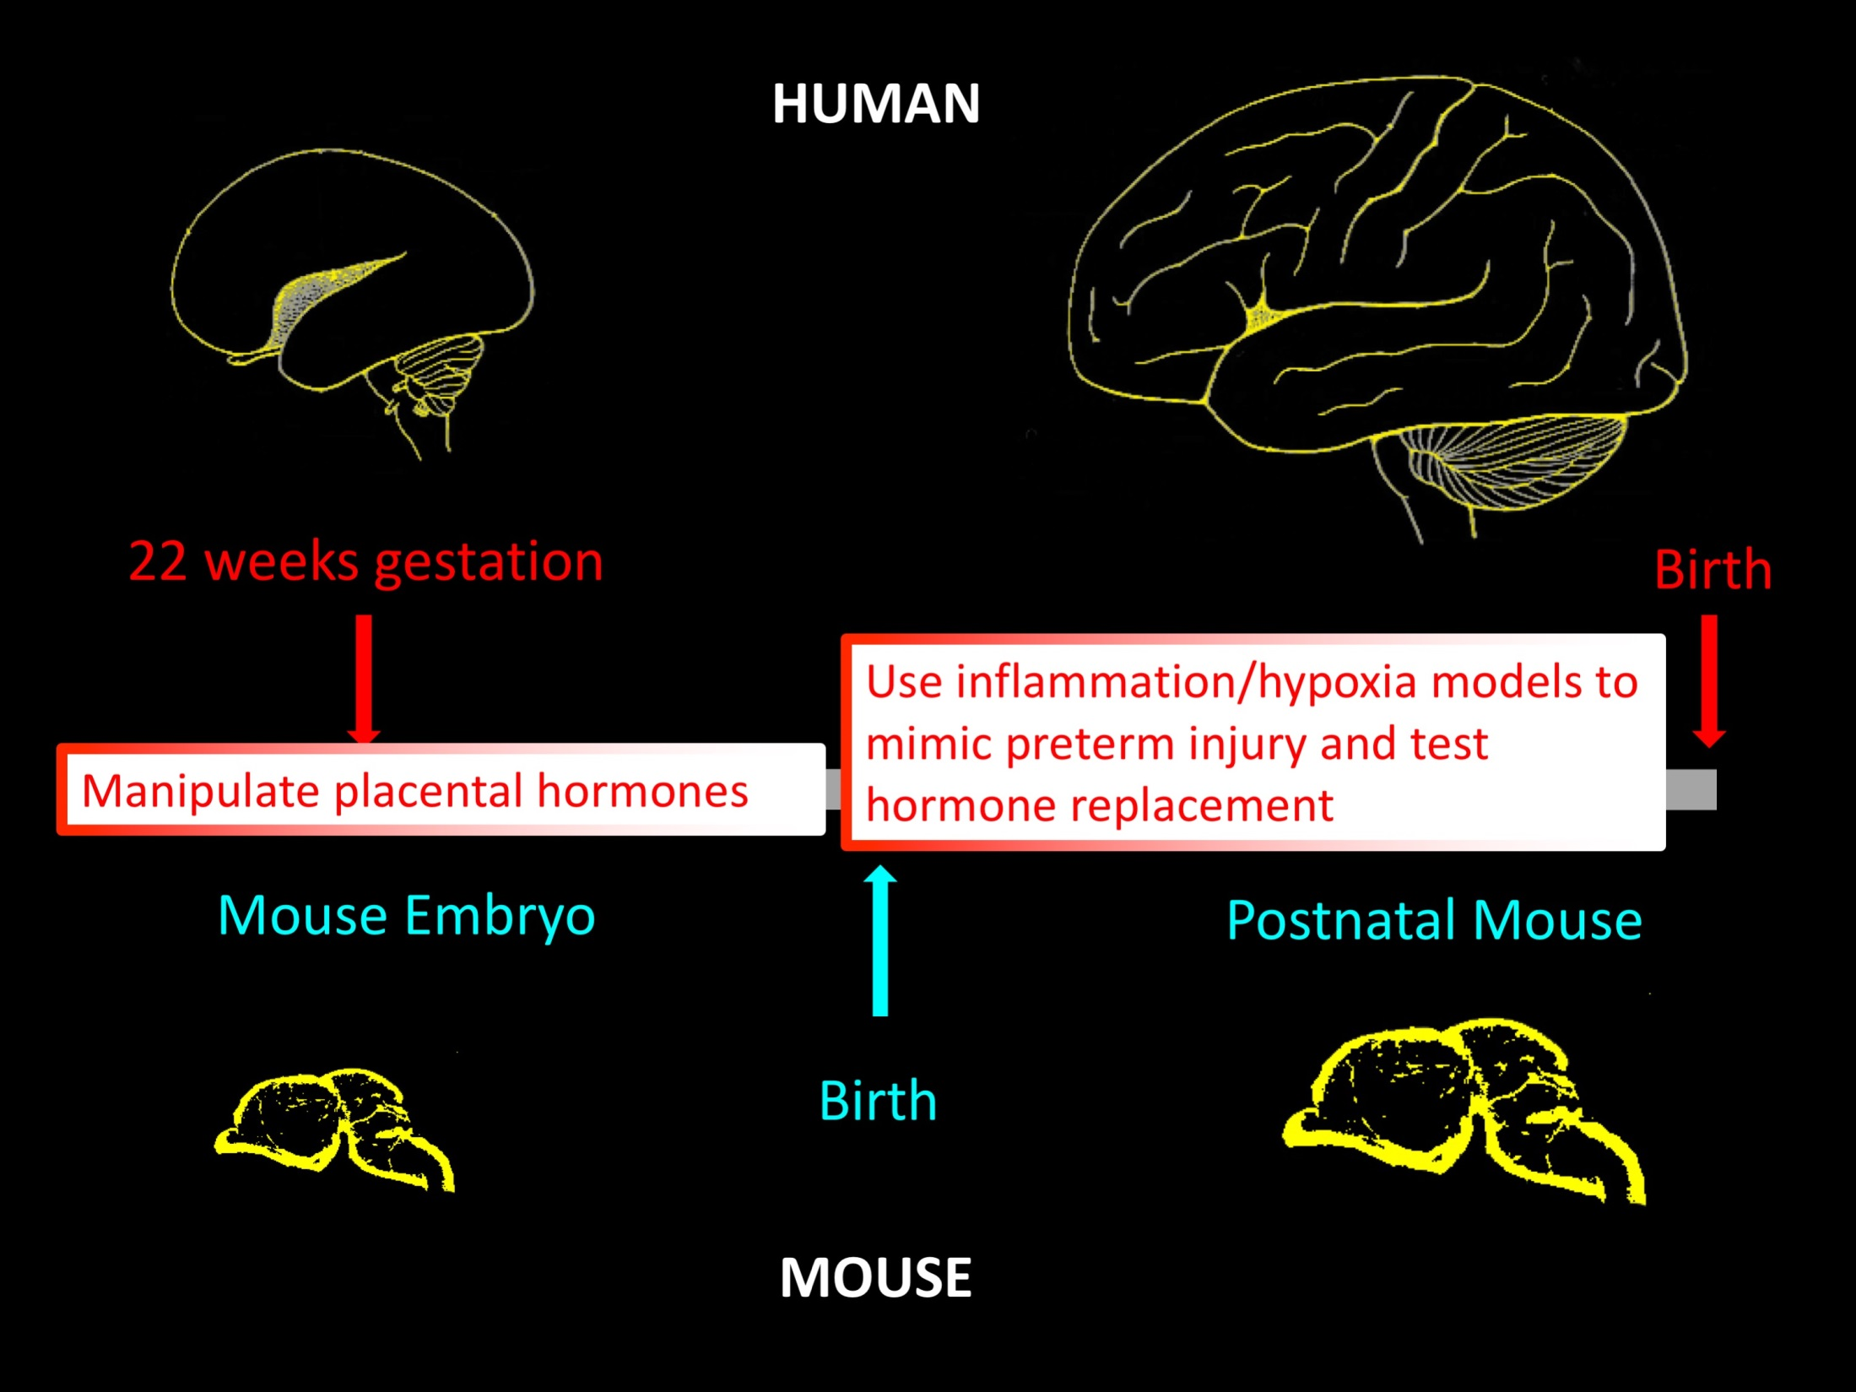

Slide 14
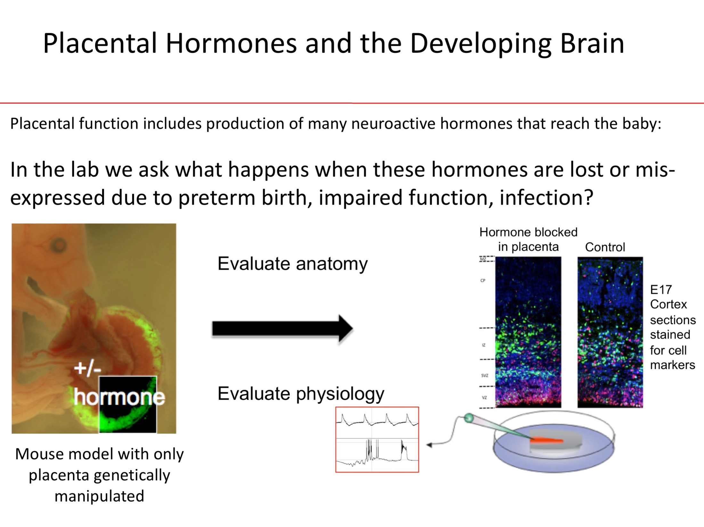

Slide 15
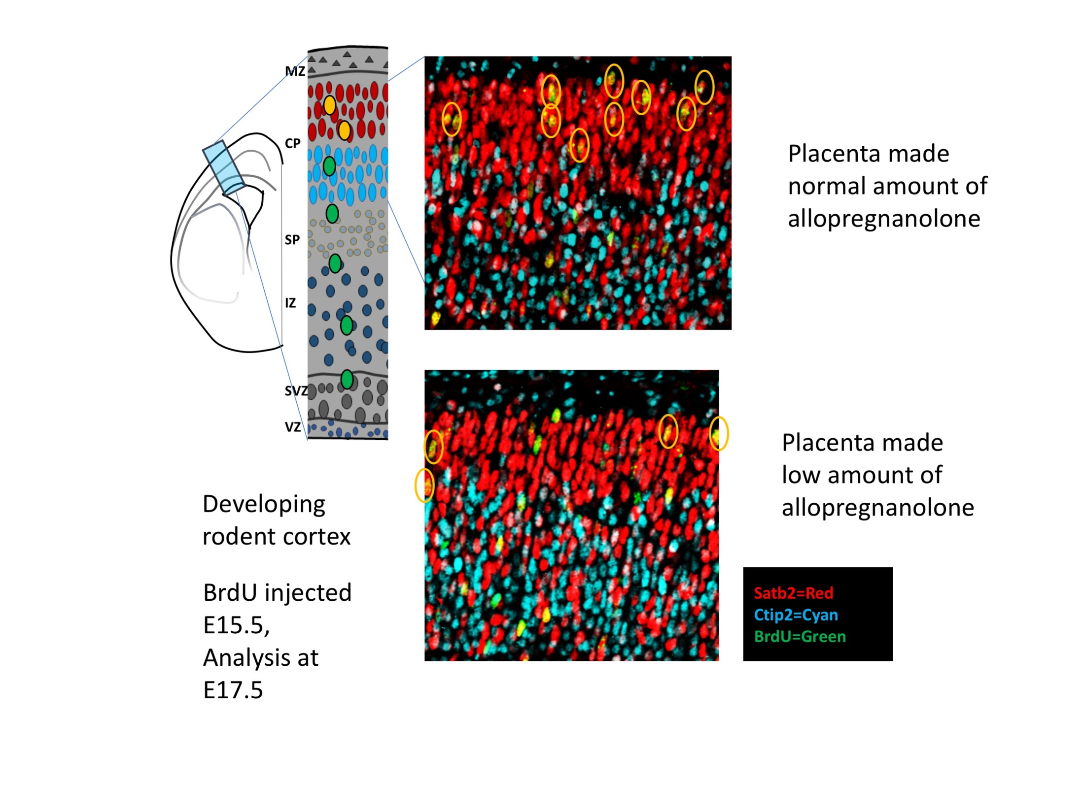

Slide 16
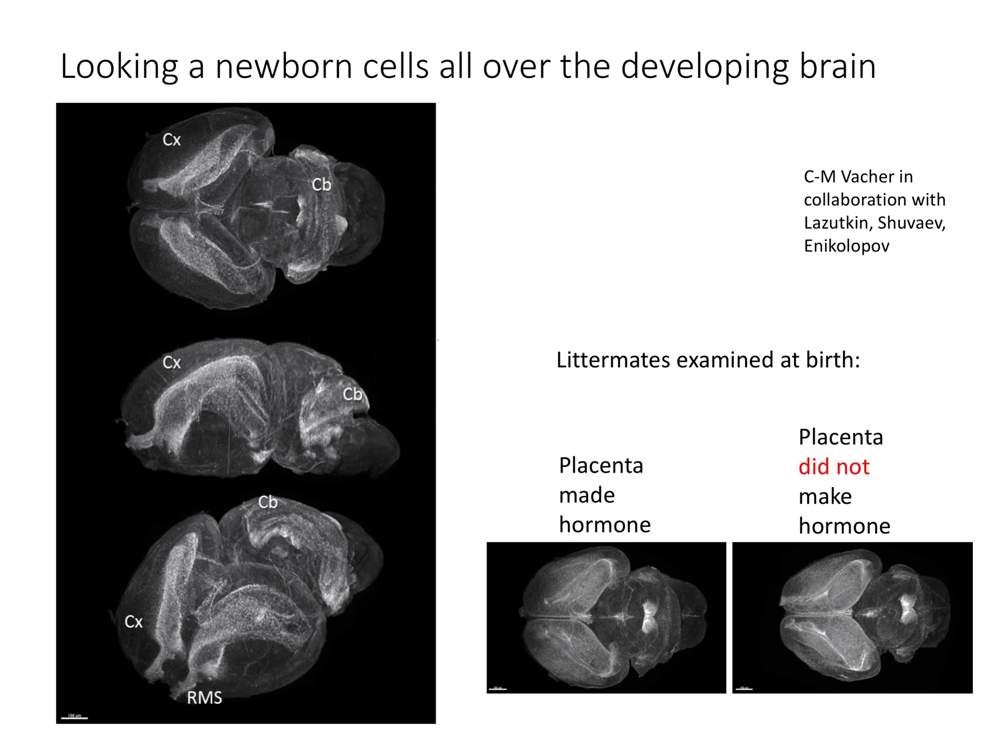

Slide 17
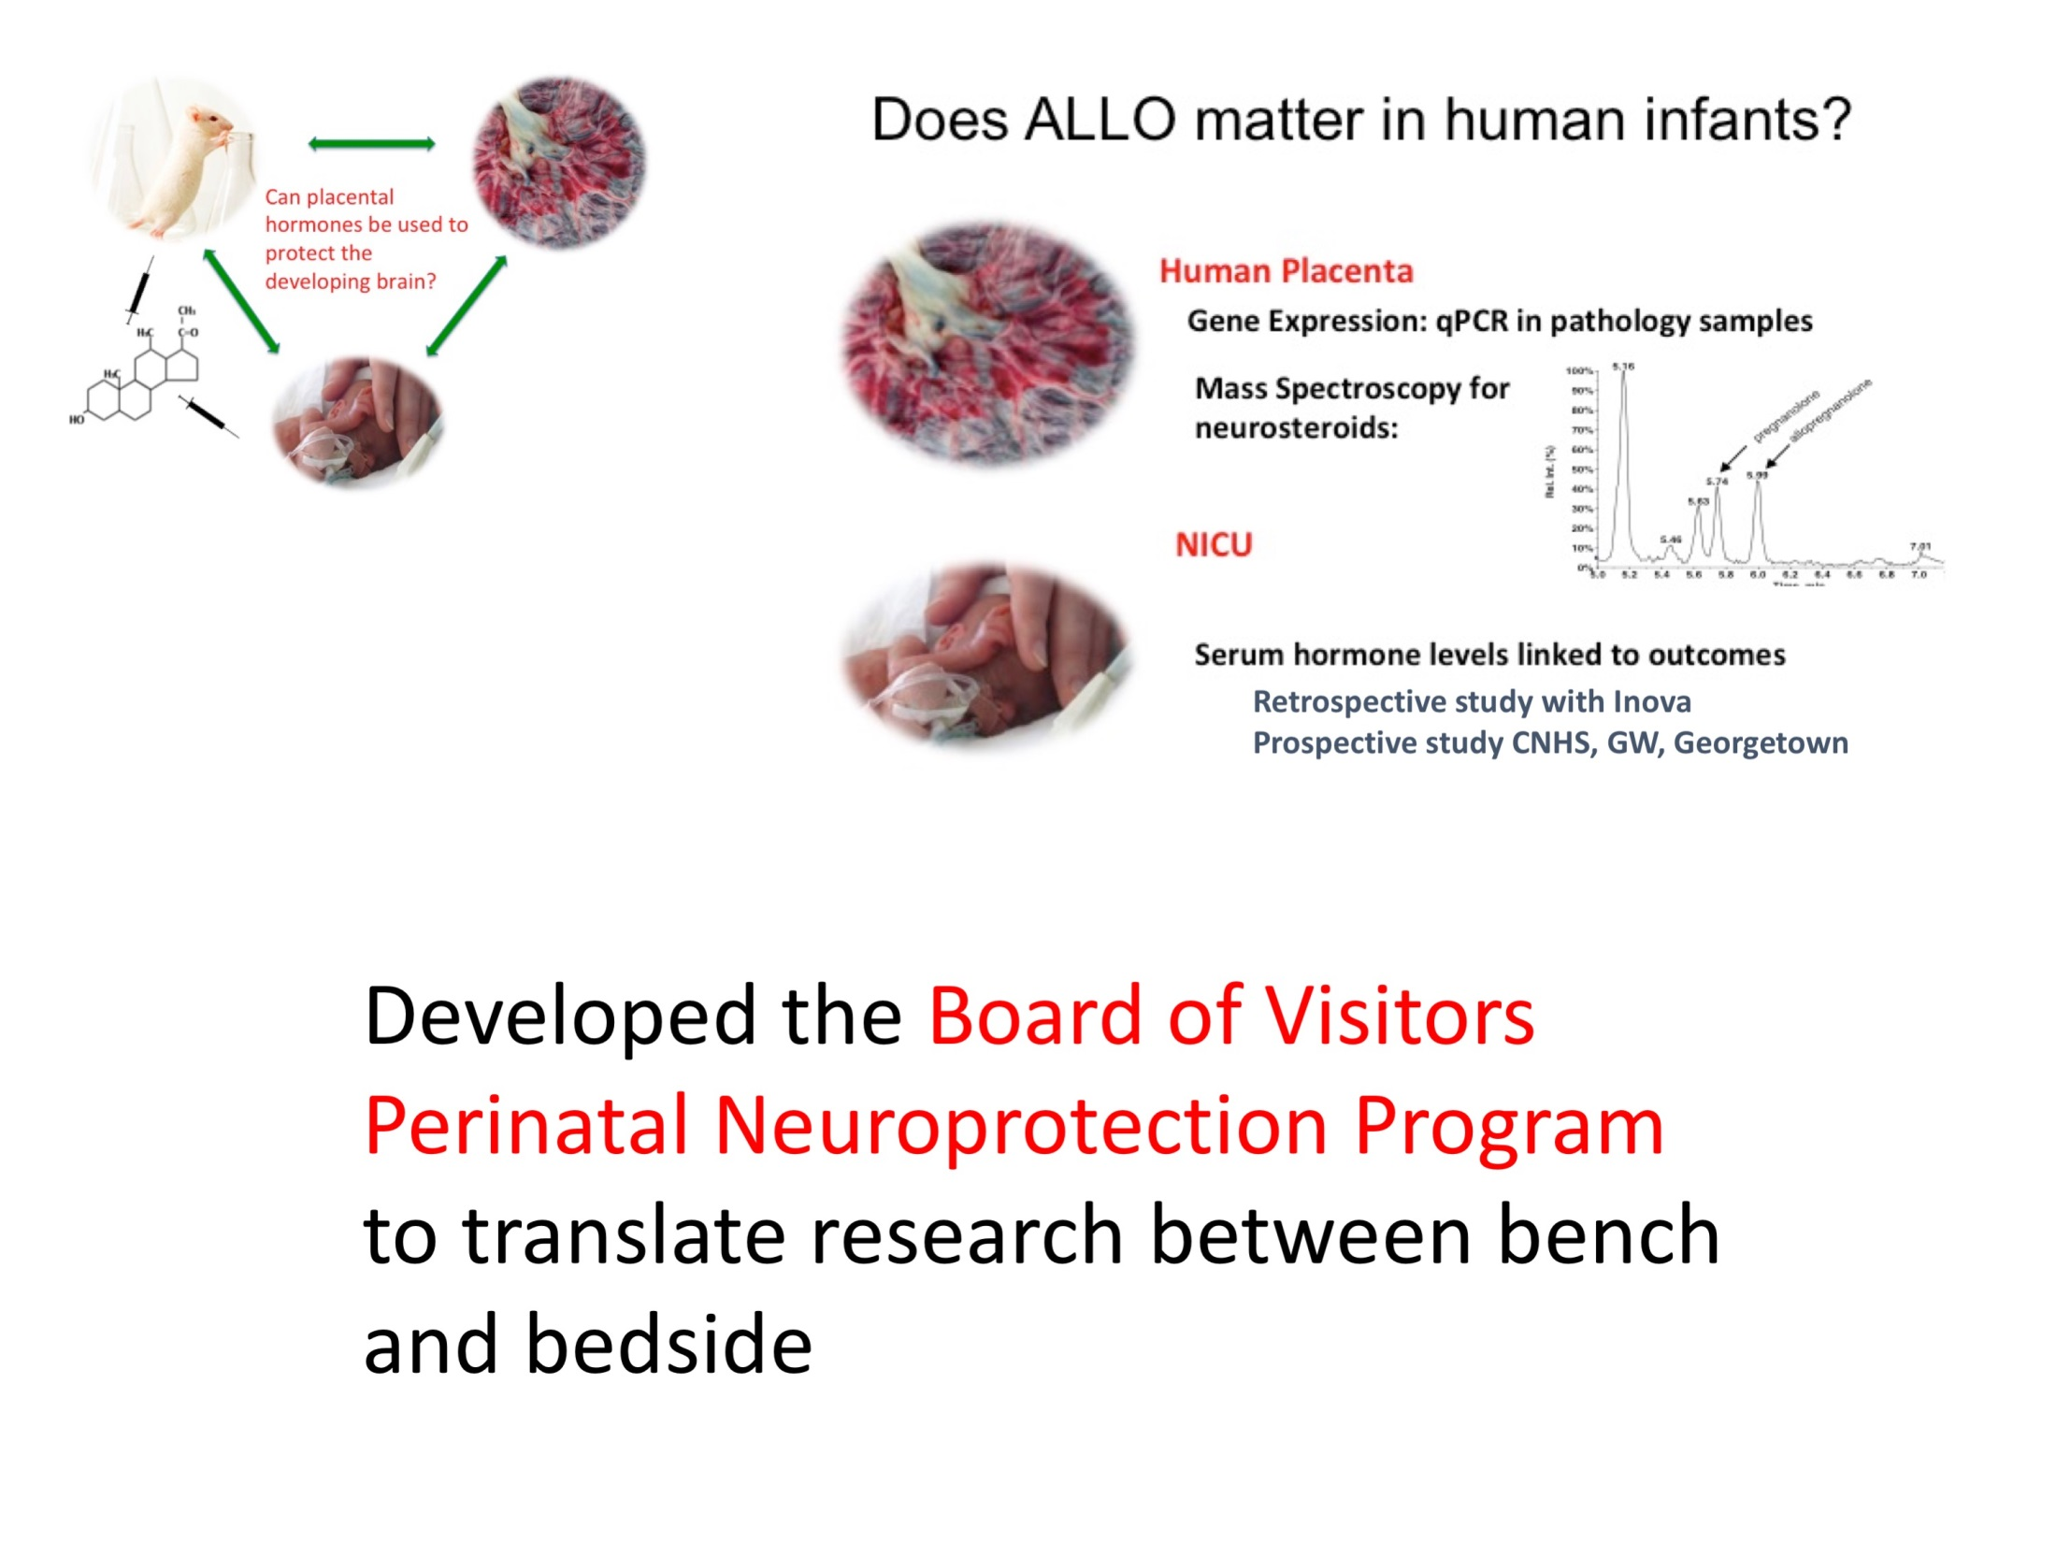

Slide 18
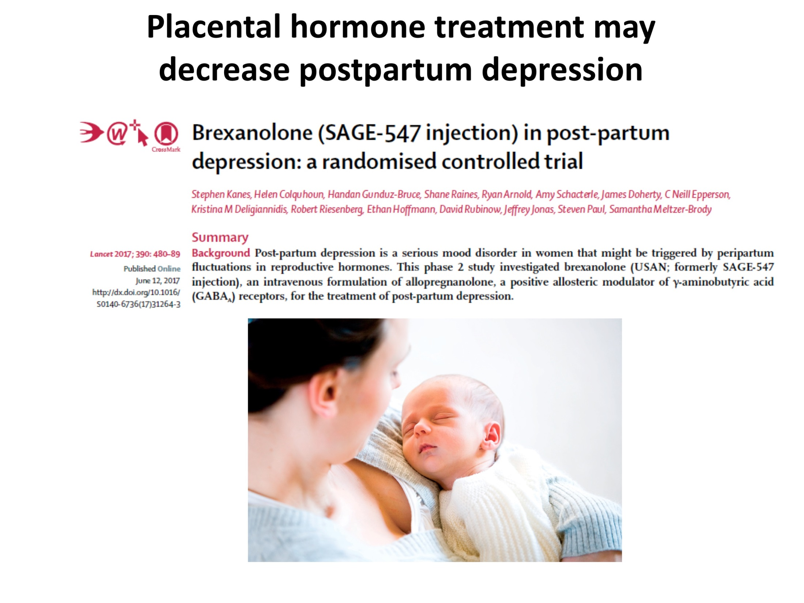

Slide 19
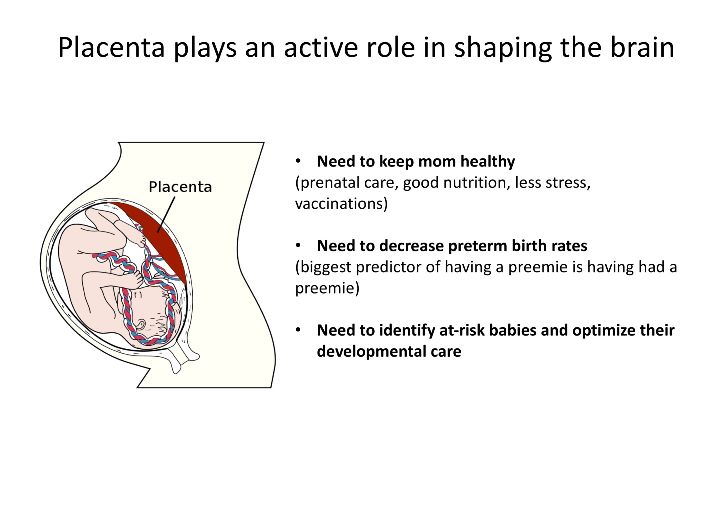

Slide 20
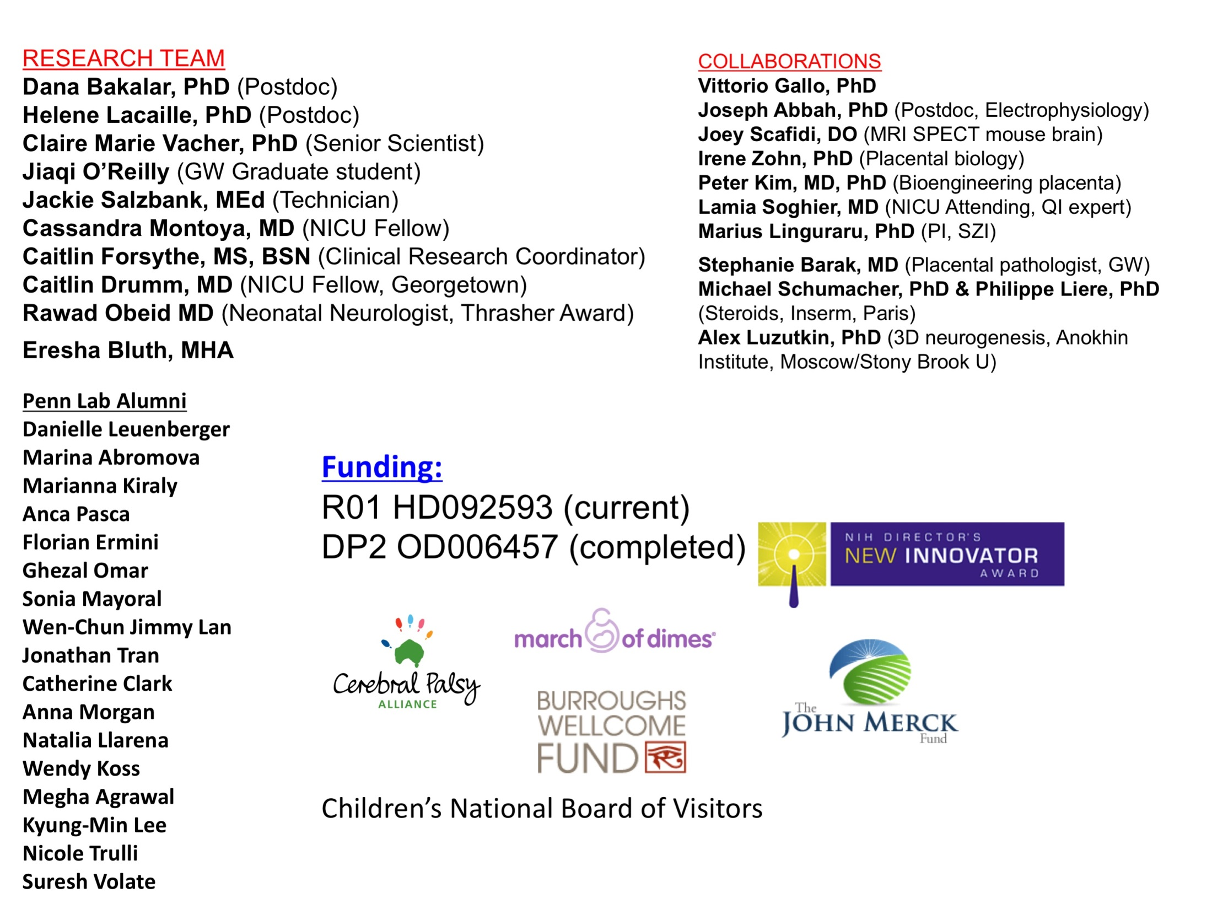

Slide 21


Early Childhood Innovation Network:
Moving from Science to Action
CTSI-CN 360 Science Café
November 1, 2017
Dr. Lee Beers

Slide 22


Multi-generational and grounded in science
Collaborative across sectors
Guided by community knowledge and experience
Connected to existing resources
Notes:
We plan to go through slides 2-5 very quickly, and really only discuss the top lines in bold (bulleted points can be for reference only). Will use story(s) of child and family as thread through the presentation

Slide 23

Transformative Action for Children
OUR VISION IS
FOR EVERY CHILD
TO BE ABLE TO
REACH HER
FULL POTENTIAL
Build adult capacities to nurture young children
Enhance developmental outcomes for young children
Empower and support families
Mitigate the impact of toxic stress

Slide 24

Transformative Action for Institutions
OUR VISION IS THAT EVERY FAMILY HAS ACCESS TO PERSONALIZED QUALITY CARE
Research and advocacy
Foster collaborative relationships across
Clinical Care
Philanthropy and fundraising

Slide 25

Transformative Action for the City
OUR VISION IS THAT WASHINGTON DC IS A NATIONAL LEADER IN EARLY CHILDHOOD
Ignite a spirit of innovation and excitement
Bring together initiatives around health and education
Powerful voice for collaborative energy focused on young kids
Inform policy and system change

Slide 26



Our Innovations for Children and Families
In Prenatal Care, the Mothers-Babies Program will support the mental health of high risk pregnant women during their prenatal visits
Will serve 200+ pregnant women in 2018
In Pediatric Primary Care, Healthy Steps is providing parenting and mental health support to families with young children
Will serve ~400 families by end of 2017 & expected to serve 600 families in 2018
In Early Childhood Education, we provide mindfulness training for parents and training in social-emotional learning for teachers
200 children in class with ECIN trained teachers & 800 children in classrooms with mental health consultation in School Year 2017-18

Slide 27


From Innovation to Public Policy
Collaborations with agency leaders to change policy
Education and outreach to city government
Build sustainability and capacity of partners

Slide 28

From Innovation to National Impact
All Children Thrive
Notes:
Also note we are receiving supplemental funding; these are national partners we are engaging with in a variety of ways, or where we have done presentations nationally

Slide 29

What we hope to achieve in the next three years and beyond

Slide 30

Our Emerging Vision
Building on our growth and success to inspire a citywide movement to advance family and early childhood wellbeing
Keep parents well: protect and enhance parent mental health
Build healthy brains: optimize early childhood developmental outcomes
Prepare children to learn: readiness for school at age 5
A national model for transforming early childhood outcomes
Notes:
Talk big picture in this slide, emphasizing the momentum and enthusiasm

Slide 31







THANK YOU!

Slide 32
Gail Avent, J.D., M.B.A., CPS
Engagement: Keeping Children, and Families Connected to System of Care and Early Childhood Innovation Network of Care
Notes:
Thanks to the Clinical Translational Science Institute for extending this invitation to talk about how I created a grassroots family support organization using my challenges and stumbling blocks in life to empower and support families, children and youth emotional and mental health challenges. Every day, we work side-by-side with our families, youths and communities to make sure that we're giving our best to assist with their needs.
I am the founder and executive director of TFCC. I wear many hats in the community with pleasure. I serve as the Lead Family Advocate for DBH. I am a proud community leader on the Early Childhood Innovation Network team with National Children’s Hospital and Georgetown University. Led by great leaders Dr. Lee Beers and Dr. Matt Biel.
I want to share how my family journey brought me to a place of wanting to advocate for youth and families in the District of Columbia. I have a son with a mental health diagnosis who suffered emotional trauma as did my other three children. I lived in an abusive relationship knowing that I was too afraid to do something about it and later having to fight in court to get my children back through a long bitter battle. That fight did not make me mad. I instead took action, I divorced my husband and became an advocate for my family. Today, I work with system of care and community efforts to make sure families are not shamed and blamed when accessing needed services.

Slide 33
Invite and Support Family to Participate in the Development and Identifying Tailored Services and Community Resources
Systems of care must have a policy statement that values family participation and involvement in system change.
The invitation to be at the table must include participation in the development of specific strategies for engaging, involving and supporting youth and their families, and valuing our lived experience as insight for making change.
Notes:
Remember “Nothing about us, without us”

Slide 34
Promote Family Healing to Support Life Journeys
Know that most families will need your help and will require motivation to accept your help
Assess the needs of the entire family – reaching beyond the youth’s immediate needs!
Provide and/or coordinate the receipt of necessary services and interventions for family members
In other words, building a bridge that has meaningful pathways to help parents recognize that our child’s healthy development leads to success toward their future and to celebrate our children’s successes along the journey
Notes:
Know that most families will need your help and will require motivation to accept your help.
Sometimes we lose trust in systems
Assess the needs of the entire family – reaching beyond the youth’s immediate needs! I needed help to manage juggling a career, an abusive relationship and taking care of my children.
Provide and/or coordinate the receipt of necessary services and interventions for family members.
I had to understand that raising children’s through life challenges is a long journey. I come to value their strength which energized me to stay on the journey with them.
In other words, building a bridge that has meaningful pathways to help parents recognize that our child’s healthy development leads to success toward their future and to celebrate our children’s successes along the journey

Slide 35
Design Systems of Care to Engage and Strengthen Families (Family Empowerment)
The system of care must:
  Include a family component – that is coordinated and integrated to support children and youth a good mental health foundation
  Help family members to “Re-Tune Their Voice and Spoken Word” – to assist family members with adjusting their communication style to meet the youth where they are; and to build a better relationship with the children and service delivery systems.
  Value having a partnership between the provider and the family!
  Have a youth and family education component!
  Assist with the removal of barriers incurred by policies/legislations and program requirements that deter access to quality care and treatment completion.
Notes:
* Design system of care to Engage and Strengthen Families ( Family Empowerment)
The System of Care must:
Include a family component – that is coordinated and integrated to support the children and youth !
* Help family members to “Re-Tune Their Voice and Spoken Word” to assist family members with adjusting their communication style to meet children where they are; and to build a better relationship with the child and the service delivery systems.
I had to learn to stop telling them and to start asking them questions, like “How was your day? What did you learn today? Are you ok?
*Value having a partnership between the provider and the family!
We want to be your partner. What better way to demonstrate to our children we are working together to help them through their journey.
*Have a youth and family education component!
Create written materials that we can share and with our children and multi-generational family members. Give us homework together.
* Assist with the removal of barriers incurred by policies/legislations and program requirements that deter access to quality care and treatment completion.

Slide 36
Early Childhood Innovation Network (ECIN) Leading the Way to Develop Community Services by Partnering with the Community
ECIN:
  Respect Communities- Ask for permission
  Built a Strong Team
  Dr. Beers and Dr. Biel lead the team
    Community Leaders advise the team
    The Community leads the team
  My Role – Build a dynamic – Parent Advisory Council (PAC)
    Constant reminders to ECIN to answer the question - Nothing about me, without us.
    Support the PAC through their leadership growth
    Help them understand how generational cycles of abuse impacts our parenting skills
    Sensitize them to how competing family challenges impact safe communities
  Demonstrate to all that ECIN cares about helping parent to understand the stages of their child development.
  ECIN Family – We working hard for you!

Slide 37
Family Matters!
Thank you!
Notes:
In other words, Family Matters to us! We want you to know you also matters.
Thank you!

Slide 38
Save the Date
Science Café
Tuesday, December 5, 2017
6 pm – 8 pm

